Slide 1
Results from a large Australian PrEP demonstration study: discontinuation and subsequent HIV and other sexually transmitted infection risk
Kathleen Ryan, Jason Asselin, Luxi Lal, Long Nguyen, Matthew Penn, Brian Price, Norm Roth, Simon Ruth, BK Tee, Michael West, Jeff Wilcox, Kit Fairley, Margaret Hellard, Jennifer Hoy, Mark Stoove, Edwina Wright
On behalf of the PrEPX Study team

Slide 2
Conflicts of interest
None to declare
Study funding
Victorian Department of Health and Human Services
Alfred Health
Thorne Harbour Health

Slide 3
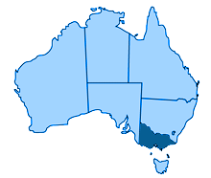
HIV in Victoria
Victoria
Second most populous state in Australia
Population ~6.5 million
Universal healthcare system provides subsidised medical appointments and pharmaceuticals

Slide 4
HIV in Victoria
Victoria
Second most populous state in Australia
Population ~6.5 million
Universal healthcare system provides subsidised medical appointments and pharmaceuticals
Approximately 300 new HIV diagnoses each year
75% of new diagnoses among men who have sex with men ¹
Declining number of new infections from 2016 ²
Likely due to scale up of treatment as prevention and PrEP
Declines concentrated among men who have sex with men
Victorian DHHS, 2019
Kirby Institute, 2019

Slide 5
Background – The PrEPX Study
Population Level Demonstration Study
Primary aim Reduce HIV incidence by 25% at population level and Reduce HIV incidence by 30% among GBM
Study design
Opened 26 July 2016
Closed: 31 March 2018
Recruit 2600 people at high risk of HIV
Additional study places opened following significant interest and funding
Participants attend study visits every 3 months
HIV/STI testing
dispensed 90 pills

Slide 6
PrEPX participant characteristics
 | n (%)
Number enrolled | 4275
Number included in analysis ¹ | 3489
Number of dispensing events | 16,689
Clinic site type
Primary care clinic | 2280 (65.4)
Sexual health clinic | 751(21.5)
Hospital or outreach | 458(13.1)
1. Analysis restricted to participants who enrolled prior to 01October2017 and recorded any PrEP dispensing event

Slide 7
PrEPX participant characteristics
 | n (%)
Number included in analysis | 3489
Median age (IQR) | 34 (29-43)
Male (cis/trans) gender | 3452 (99.0)
Trans or gender diverse | 39 (1.1)
Gay or bisexual identity | 3445 (98.7)
Previous PrEP use | 880 (25.3)
Condomless anal intercourse ^{1,2} | 2529(72.5)
Methamphetamine use^{1,2} | 457 (13.1)
Injecting drug use^{1,2} | 173 (5.0)
Enrolled at clinician’s discretion² | 1099 (31.5)
Three month recall
Reasons for enrolment not mutually exclusive

Slide 8
Aims
Estimate the number of PrEPX participants who discontinued PrEP use during the study
Estimate predictors that are associated with discontinuing PrEP
Describe HIV and STI positivity among a subset of participants who discontinued PrEP

Slide 9
Data Sources
PrEPX enrolment survey
Completed by enrolling clinician/nurse
Completed at enrolment for every participant
Pharmacy log
Completed by study pharmacist
Completed at every dispensing event
ACCESS data
Australian Collaboration for Coordinated Enhanced Sentinel Surveillance
Non-identifiable patient data extracted from clinic Patient Management System
Individuals are linked within and between ACCESS clinics
Five PrEPX study sites participate in ACCESS

Slide 10
Data Sources
PrEPX enrolment survey
Completed by enrolling clinician/nurse
Completed at enrolment for every participant
Pharmacy log
Completed by study pharmacist
Completed at every dispensing event
ACCESS data
Australian Collaboration for Coordinated Enhanced Sentinel Surveillance
Non-identifiable patient data extracted from clinic Patient Management System
Individuals are linked within and between ACCESS clinics
Five PrEPX study sites participate in ACCESS

Slide 11
Data Sources
PrEPX enrolment survey
Completed by enrolling clinician/nurse
Completed at enrolment for every participant
Pharmacy log
Completed by study pharmacist
Completed at every dispensing event
ACCESS data
Australian Collaboration for Coordinated Enhanced Sentinel Surveillance
Non-identifiable patient data extracted from clinic Patient Management System
Individuals are linked within and between ACCESS clinics
Five PrEPX study sites participate in ACCESS

Slide 12
Analysis
Aim 1
Generate discontinuation outcome
Survival analysis of time to discontinuation
Aim 2
Cox regression to determine baseline covariates associated with discontinuation
Aim 3
HIV positivity following discontinuation
Descriptive analysis of STI positivity before and after discontinuation

Slide 13
Analysis
Aim 1
Generate discontinuation outcome
Survival analysis of time to discontinuation
Aim 2
Cox regression to determine baseline covariates associated with discontinuation
Aim 3
HIV positivity following discontinuation
Descriptive analysis of STI positivity before and after discontinuation

Slide 14
Analysis
Aim 1
Generate discontinuation outcome
Survival analysis of time to discontinuation
Aim 2
Cox regression to determine baseline covariates associated with discontinuation
Aim 3
HIV positivity following discontinuation
Descriptive analysis of STI positivity before and after discontinuation

Slide 15
1. Estimate the number of PrEPX participants who discontinued PrEP use during the study

Slide 16
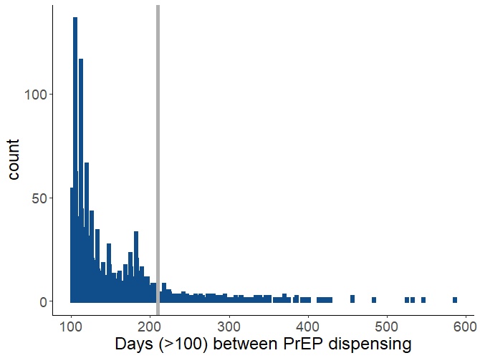
Define discontinuation
85 participants officially withdrew
Time between study visits suggested more people stopped attending
Estimated the time between study drug dispensing events
Time between visits when >100 days
90%:210 days

Slide 17
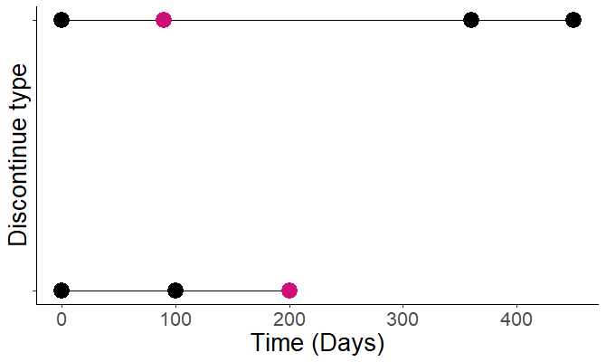
Define discontinuation
The last dispensing event prior to
>210 days before next dispensing event OR
>210 days between last event and the end of the study The first discontinuation event was recorded per participant
PrEP dispensing event
Discontinuation

Slide 18
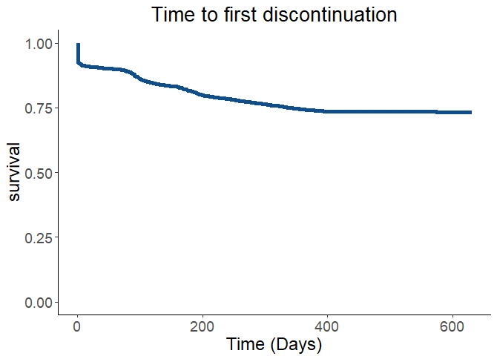
Estimate the number of participants who discontinued PREP
877 (25%) participants discontinued PrEP
During follow up
197 (22%) recommenced PrEP
680 ( 78%) did not recommence PrEP
275 (31%) recorded one study drug dispensing

Slide 19
2. Estimate predictors that are associated with discontinuing PrEP

Slide 20
Determine covariates associated with discontinuing PrEP
 |  | HR (95%CI) | aHR (95%CI)
Age | 16-29 | 1.82 (1.53-2.16) | 1.75 (1.47-2.09)
 | 30-39 | 1.41 (1.19-1.68) | 1.39 (1.17-1.65)
 | 40+ | Ref | Ref
Trans or gender diverse |  | 1.73 (1.04-2.87) | 1.45 (0.87-2.42)
PrEP naïve at baseline |  | 1.51 (1.28-1.79) | 1.44 (1.21-1.71)
Injecting drug use ^{1,2} |  | 1.55 (1.20-2.01) | 1.64 (1.23-2.19)
Methamphetamine use ^{1,2} |  | 1.23 (1.02-1.47) | 1.34 (1.11-1.61)
Enrolled at clinician discretion |  | 1.20 (1.05-1.38) | 1.27 (1.04-1.55)
Three month recall
Reasons for enrolment not mutually exclusive
Covariates not significant at univariate level include condomless anal sex, Site type

Slide 21
Determine covariates associated with discontinuing PrEP
 |  | HR (95%CI) | aHR (95%CI)
Age | 16-29 | 1.82 (1.53-2.16) | 1.75 (1.47-2.09)
 | 30-39 | 1.41 (1.19-1.68) | 1.39 (1.17-1.65)
 | 40+ | Ref | Ref
Trans or gender diverse |  | 1.73 (1.04-2.87) | 1.45 (0.87-2.42)
PrEP naïve at baseline |  | 1.51 (1.28-1.79) | 1.44 (1.21-1.71)
Injecting drug use ^{1,2} |  | 1.55 (1.20-2.01) | 1.64 (1.23-2.19)
Methamphetamine use ^{1,2} |  | 1.23 (1.02-1.47) | 1.34 (1.11-1.61)
Enrolled at clinician discretion |  | 1.20 (1.05-1.38) | 1.27 (1.04-1.55)
Three month recall
Reasons for enrolment not mutually exclusive
Covariates not significant at univariate level include condomless anal sex, Site type

Slide 22
Determine covariates associated with discontinuing PrEP
 |  | HR (95%CI) | aHR (95%CI)
Age | 16-29 | 1.82 (1.53-2.16) | 1.75 (1.47-2.09)
 | 30-39 | 1.41 (1.19-1.68) | 1.39 (1.17-1.65)
 | 40+ | Ref | Ref
Trans or gender diverse |  | 1.73 (1.04-2.87) | 1.45 (0.87-2.42)
PrEP naïve at baseline |  | 1.51 (1.28-1.79) | 1.44 (1.21-1.71)
Injecting drug use ^{1,2} |  | 1.55 (1.20-2.01) | 1.64 (1.23-2.19)
Methamphetamine use ^{1,2} |  | 1.23 (1.02-1.47) | 1.34 (1.11-1.61)
Enrolled at clinician discretion |  | 1.20 (1.05-1.38) | 1.27 (1.04-1.55)
Three month recall
Reasons for enrolment not mutually exclusive
Covariates not significant at univariate level include condomless anal sex, Site type

Slide 23
Determine covariates associated with discontinuing PrEP
 |  | HR (95%CI) | aHR (95%CI)
Age | 16-29 | 1.82 (1.53-2.16) | 1.75 (1.47-2.09)
 | 30-39 | 1.41 (1.19-1.68) | 1.39 (1.17-1.65)
 | 40+ | Ref | Ref
Trans or gender diverse |  | 1.73 (1.04-2.87) | 1.45 (0.87-2.42)
PrEP naïve at baseline |  | 1.51 (1.28-1.79) | 1.44 (1.21-1.71)
Injecting drug use ^{1,2} |  | 1.55 (1.20-2.01) | 1.64 (1.23-2.19)
Methamphetamine use ^{1,2} |  | 1.23 (1.02-1.47) | 1.34 (1.11-1.61)
Enrolled at clinician discretion |  | 1.20 (1.05-1.38) | 1.27 (1.04-1.55)
Three month recall
Reasons for enrolment not mutually exclusive
Covariates not significant at univariate level include condomless anal sex, Site type

Slide 24
Determine covariates associated with discontinuing PrEP
 |  | HR (95%CI) | aHR (95%CI)
Age | 16-29 | 1.82 (1.53-2.16) | 1.75 (1.47-2.09)
 | 30-39 | 1.41 (1.19-1.68) | 1.39 (1.17-1.65)
 | 40+ | Ref | Ref
Trans or gender diverse |  | 1.73 (1.04-2.87) | 1.45 (0.87-2.42)
PrEP naïve at baseline |  | 1.51 (1.28-1.79) | 1.44 (1.21-1.71)
Injecting drug use ^{1,2} |  | 1.55 (1.20-2.01) | 1.64 (1.23-2.19)
Methamphetamine use ^{1,2} |  | 1.23 (1.02-1.47) | 1.34 (1.11-1.61)
Enrolled at clinician discretion |  | 1.20 (1.05-1.38) | 1.27 (1.04-1.55)
Three month recall
Reasons for enrolment not mutually exclusive
Covariates not significant at univariate level include condomless anal sex, Site type

Slide 25
Determine covariates associated with discontinuing PrEP
 |  | HR (95%CI) | aHR (95%CI)
Age | 16-29 | 1.82 (1.53-2.16) | 1.75 (1.47-2.09)
 | 30-39 | 1.41 (1.19-1.68) | 1.39 (1.17-1.65)
 | 40+ | Ref | Ref
Trans or gender diverse |  | 1.73 (1.04-2.87) | 1.45 (0.87-2.42)
PrEP naïve at baseline |  | 1.51 (1.28-1.79) | 1.44 (1.21-1.71)
Injecting drug use ^{1,2} |  | 1.55 (1.20-2.01) | 1.64 (1.23-2.19)
Methamphetamine use ^{1,2} |  | 1.23 (1.02-1.47) | 1.34 (1.11-1.61)
Enrolled at clinician discretion |  | 1.20 (1.05-1.38) | 1.27 (1.04-1.55)
Three month recall
Reasons for enrolment not mutually exclusive
Covariates not significant at univariate level include condomless anal sex, Site type

Slide 26
Determine covariates associated with discontinuing PrEP, restricted to ACCESS sites
 | aHR (95%CI)
Age <30 years | 1.65 (1.09-2.50)
PrEP naïve at baseline | 1.67 (1.11-2.48)
Consistent condom use with casual partners | 1.52 (1.01-2.30)
No association observed between number of anal sex partners, group sex, drug use before/during sex and discontinuation

Slide 27
3. Describe HIV and STI positivity among a subset of participants who discontinued PrEP
743 ACCESS site participants discontinued
440 had subsequent HIV test
158 (36%) recommenced PrEP
460 had subsequent STI test

Slide 28
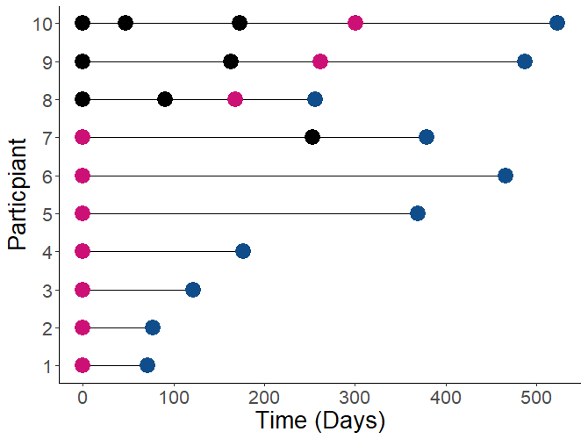
HIV positivity among participants who discontinued PrEP
10 participants were diagnosed with HIV
PrEP dispensing event
Discontinuation
HIV diagnosis

Slide 29
HIV positivity among participants who discontinued PrEP
10 participants were diagnosed with HIV
2.28% positivity
199 days median time between last PrEP dispensing event and HIV diagnosis
PrEP dispensing event
Discontinuation
HIV diagnosis

Slide 30
HIV positivity among participants who discontinued PrEP
10 participants were diagnosed with HIV
2 participants were likely missed positive at baseline
PrEP dispensing event
Discontinuation
HIV diagnosis

Slide 31
HIV positivity among participants who discontinued PrEP
10 participants were diagnosed with HIV
2 participants were likely missed positive at baseline
4 other participants only had 1 PrEP dispensing event
PrEP dispensing event
Discontinuation
HIV diagnosis

Slide 32
HIV positivity among participants who discontinued PrEP
10 participants were diagnosed with HIV
2 participants were likely missed positive at baseline
4 other participants only had 1 PrEP dispensing event
1 participant accessed PrEP after discontinuation
PrEP dispensing event
Discontinuation
HIV diagnosis

Slide 33
HIV positivity among participants who discontinued PrEP
10 participants were diagnosed with HIV
2 participants were likely missed positive at baseline
4 other participants only had 1 PrEP dispensing event
1 participant accessed PrEP after discontinuation
3 participants diagnosed after multiple PrEP dispensing events
PrEP dispensing event
Discontinuation
HIV diagnosis

Slide 34
STI diagnosis among participants who discontinued PrEP
No difference in STI positivity observed before/after discontinuation
 |  | Before discontinuation | After discontinuation
 |  | n(%) | n(%) | p=
Gonorrhoea | Negative | 1053 (92.4) | 1066 (91.8)
 | Positive | 87 (7.6) | 95 (8.2) | 0.62
Chlamydia | Negative | 1036 (92.2) | 1035 (91.6)
 | Positive | 88 (7.8) | 95 (8.4) | 0.61
Syphilis | Negative | 1078 (98.4) | 1006 (97.4)
 | Positive | 18 (1.6) | 27 (2.6) | 0.11

Slide 35
Key Findings
Aim 1 | 25% of participants discontinued Lower discontinuation than observed in other studies ^{1,2,3} Includes participants who re-commenced PrEP use
Aim 2 | Discontinuing was associated with Younger age No previous PrEP use Injecting drug use Methamphetamine use at baseline Enrolment at clinician discretion
Aim 3 | >50% of participants who discontinued returned for HIV/STI testing 10 participants were diagnosed with HIV 6 of these participants only had one PrEP dispensing event STI positivity was similar during and after discontinuation
Spinelli, 2018
Krakower, 2019
Koy, 2019

Slide 36
Discussion
PrEP may only be needed during periods of higher risk
Clinician discretion was associated with discontinuation – most participants enrolled at clinicians discretion did report high risk ^{1,2}
Individuals discontinued then resumed PrEP use
Provide HIV prevention support when deciding to stop PrEP use
HIV diagnoses and similar STI positivity suggest continued risk for some people following discontinuation
Perceived risk may be lower than actual risk
Support people who face barriers to PrEP use
Naïve to PrEP may not expect side effects when initiating PrEP?
Younger age may face financial barriers that limits PrEP use
Methamphetamine use and injecting drug use more likely to discontinue – different support needed than for gay and bisexual men?
Cornelisse et. al. 2018
Asselin et. al. 2018

Slide 37
Discussion
On-demand PrEP could address barriers to PrEP use
High interest in Australia ¹
Recently included in National PrEP prescribing guidelines ²
(Very) recently included in WHO guidelines ³
May overcome concerns about daily use, better for intermittent risk, lower cost
More work is needed to understand when and why people decide to start, stop, and take a break from PrEP
Changing data needs at PrEP research moves from efficacy to implementation
Surveillance data allows exploration of population level roll-out of PrEP
Qualitative data can fill in the gaps of surveillance data
Cornelisse et. al. 2019
Wright et. al. 2018
WHO, 2019

Slide 38
Acknowledgements
Alfred Health
Edwina Wright
Brian Price
Anne Mak
Luxi Lal
Dean Murphy
Jude Armishaw
Timmy Lockwood
Olga Vujovic
Christina Chang
Vincent Cornelisse
Sue Lee
Burnet Institute
Mark Stoové
Jason Asselin
Long Nguyen
Carol El-Hayek
Study Clinics
Prahran Market Clinic: Norm Roth
Northside Clinic: Jeff Wilcox
MSHC: Kit Fairley
PRONTO!: Matt Penn
Centre Clinic: BK Tee
ERA Health: George Forgan-Smith
Alfred HIP Clinic and Nurse Led Clinics
Pharmacies
John Silverii’s Pharmacy: John Silverii
Newton and Leung Pharmacy: Johnny Phu
Melbourne Sexual Health: Anne Mak
Alfred Clinical Trials Pharmacy: Anne Mak
Healthsmart: Joseph Tesoriero
Central Pharmacy: Manoj Vassan, Kie Lim
Russell Frajman Pharmacy: Russell Frajman
ACCESS
Burnet Institute, Kirby Institute & NRL
CSRH
Dean Murphy, John De Wit
Community Organisations
VAC: Simon Ruth, Colin Batrouney, Jeremy Wiggins
PrEP’DForChange: Chris Williams
PrEPaccessNOW: Jeff Montgomery & Michael Whelan
Living Positive Victoria: Brent Allen
Victorian Aboriginal Controlled Community Health Organisation: Kat Byron
Centre for Culture Ethnicity and Health: Alison Coelho
Harm Reduction Victoria: Jenny Kelsall
Funding Bodies
Victorian Department of Health and Human Services
Alfred Health
Thorne Harbour Health
Research Participants
PrEPX participants
Participants in previous PrEP research

Slide 39
Kathleen Ryan, PhD
HIV Biomedical Prevention Research Fellow, Alfred Health
Kathleen.ryan@burnet.edu.au
@katlizryan

