Slide 2
Long Term HIV Control in Pediatric Populations
Deborah Persaud, MD
@TwitterHandle
Share your thoughts on this presentation with #IAS2019

Slide 3
Global summary of the AIDS epidemic 2018
Estimated 1.8 million children living with HIV in 2017
Perinatal Infections continue
180,000 new infections

Slide 4
HIV IMMUNOPATHOGENESIS DIFFERS SIGNIFICANTLY IN perinatal and adult infection
Images:googleimages.com

Slide 5
High Risk of Death in First Two Years of Life with Untreated Perinatal HIV Infection
Risk of Death
35·2% die within one year
52·5% within two years
Compared with 40% within 10 years for adult infection
Differs by timing of infection
Higher with in utero and intrapartum infection
compared with breastmilk transmission
Highlighting the role of immune control and disease progression in HIV infection
Newell, M. L. et al. Lancet 364, 1236–1243 (2004)

Slide 6
Higher Plasma Viral Loads and Longer Time to Viral Load Set point in Perinatal vs. Adult HIV Infection
Plasma viral loads are typically high
10⁶-10⁷ copies/mL
Takes 3 to 5 years to reach viral load set point compared with within weeks for adults
CD4 counts decrease rapidly from birth without ART
Reviewed in Prendergast A et al. Nature Reviews Immunology 2012
Notes:
-

Slide 7
Immune Aspects of Perinatal Infection
Tolerogenic immune environment with in utero and peripartum infection
Delayed development of HIV-specific immunity to curtail virus replication
Delayed development of immunologic memory
Reviewed in Goulder PJ et al. Nature Rev. Immunology 2016

Slide 8
Non-Progressors and Elite Control in Perinatal and Adult HIV Infection
Adult
Perinatal
5–15% become long-term non-progressors
stable CD4 counts
low viral loads
associated with protective HLA-alleles
(HLA-B27, HLA-B57, HLA- B58:01 and HLA-B81:01)
~0.5% become ‘elite controllers’
Plasma viremia controlled to undetectable levels
in the absence of ART
associated with protective HLA-alleles
A small minority (<5%) become long-term non-progressors
stable CD4+ T cell counts
low viral loads
minimal clinical disease
often identified in adolescence
not HLA-associated
5-10% have a nonprogressor phenotype
high viremia but normal CD4 T cell counts
low immune activation, low CCR5 expression on central memory CD4+ T cells
not HLA-associated
Elite controller state rare (estimated 5-10x lower than in adults)
Lambotte O et al. CID 2005;
Pereyra F. et al. JID 2008; Grabar S et al. AIDS 2009; Pereyra F. et al. Science 2010; Yang OO et al. AIDS 2017
Vieira VA et al. AIDS 2019

Slide 9
Elite Controller State in Perinatal HIV Infection (2019)
Estimated prevalence of 0.08% (95% CI 0.04 – 0.14%)
11 cases in 23,359 children from 10 cohorts in South Africa, Brazil, Thailand and Europe
Takes years to achieve
median age of viremia control of 6.5 years
Associated with early loss of immune control
46% (5/11) lost control of viremia at a median age of 12.6 years
Associated with being female
91% of 11 were girls
HLA-association unknown-not tested
Representative case showing loss of viremic control in adolescence
Vieira VA et al. AIDS 2019

Slide 10
Perinatal vs. Adult HIV infection
Altogether, the higher risk of death, substantially longer time to reach steady-state viremia, and rarity of elite controller status highlight distinct differences in the immunopathogenesis of HIV infection in perinatal and adult infection, reflective of inherent differences in immune maturation and potential for long term control of HIV

Slide 11
Transformation of Perinatal HIV Infection with Early ART
Outcomes with Early ART
Early ART reduce early infant mortality by 76% and HIV progression by 75%.
(Median age at ART 7.4 weeks of age)
Preserves immune health
Modifies HIV persistence
small proviral reservoirs
low diversity reservoirs
minimal to absent HIV specific humoral and cellular responses
low proviral reservoir size correlated with absent or restricted antibody responses
Children with HIV Early Antiretroviral Therapy (CHER) trial. Violari A et al. NEJM 2008
Persaud D et al. JAMA Peds 2012; Ananworanich J et al. AIDS 2014; Van Zyl GU jid 2015; Van Zyl GU JCI 2017; McManus M et al. CID 2019; Rocca S et al. J Peds Infect Dis Society 2019

Slide 12
cases of post-treatment control in perinatal HIV infection WITH VERY EARLY AND EARLY art (2013-2019)

Slide 13
The Case of HIV Remission in the “Mississippi Baby”
BIRTH
30 hours
18 months
46 months
23 months
ART-free remission
for 27.6 months
Begins Triple ART regimen
as enhanced prophylaxis
Stops ART
No HIV-1 detected in blood plasma
HIV-1 detected in blood
at 2 separate time points
(in-utero infected)
Rebound Viremia
Persaud D, Gay H, Luzuriaga et al. NEJM 2013; Luzuriaga K, Gay H, Persaud D et al. NEJM 2015

Slide 14
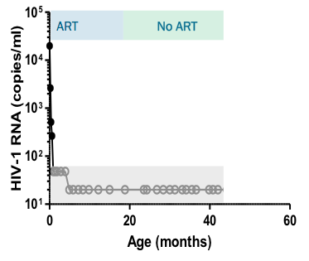
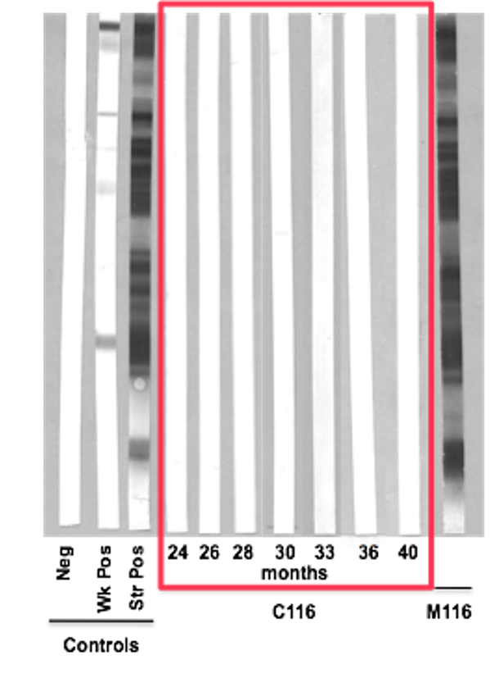
Viral and Immune Profiles of the Mississippi Baby During Post-Treatment Control
No HIV-1 specific CTLs
No plasma viremia
No latent reservoir (IUMP <0.015)
Intermittent low-level HIV DNA in PBMCs
No HIV-1 specific antibodies
No protective genetic alleles:
HLA typing: A3, A68, B7, B39, and Cw7
Wild-type CCR5
Persaud, Gay, Luzuriaga et al 2013 NEJM; Luzuriaga, Gay, Persaud et al 2015 NEJM
14

Slide 15
Rebound Viremia Profile in the ”Mississippi baby”
Remission
Clinically asymptomatic
Rebounded to near pre-ART levels
Controlled on ART
Seroconverted with rebound
Subtype B infection
Remains in follow-up
ART
No ART
ART
19,182 c/ml
16,750 c/ml;
10,564 c/ml
Persaud, Gay, Luzuriaga et al 2013 NEJM; Luzuriaga, Gay, Persaud et al 2015 NEJM

Slide 16
Post-Treatment Control in a Perinatally HIV-Infected Adolescent:“French Teenager”
Identified as PTC at 18.6 years of age
Intrapartum infection
Pre-ART viral load high: 2.1 x 10⁶ c/mL
ART at 3 months of age; two episodes of rebound viremia in the second year of life (50,000-100,000)
Stopped ART around age 5.8-6.8 yrs
Circulating HIV infected cells detectable
(2.2 log₁₀ copies/million PBMCs )
“Weak” HIV-specific CD8+ T cells
No protective HLA genotype identified
Subtype H infected
Estimated prevalence of 1/100 early-treated children in the ANRS EPH C010 Pediatric Cohort
Frange P et al. Lancet HIV 2016

Slide 17
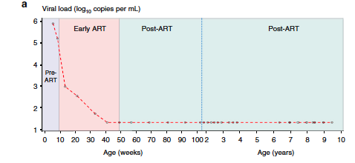
Post-Treatment Control in a Perinatally HIV-Infected “South African Boy” (2017)
Identified as PTC at 9.5 years of age
Mode of infection in utero/intrapartum; not breastfed
Peak viral load >750,000 c/mL
pre-ART viral load at 60 days 151,000 c/mL
ART started at 8.7 weeks of age and for 40 weeks as in the CHER Trial
off ART for 8.75 years
No viral rebound
Prevalence-CHER TRIAL (1/ 227; 0.4%)
Violari A et al. Nature Communications 2019

Slide 18
Virologic and Immunologic Profiles during Post-Treatment Control in the “South African Boy”
AT 9.5 years of age off ART
Detectable HIV DNA ( 5 copies/10⁶ PBMC) and HIV RNA (6.6 copies/ml)
No replication competent CD4 reservoir
Subtype C infection
Indeterminate western blot
High IgA2antibody response to gp41; Tat antibody responses
Strong NK cell response
Weak GAG CD4 response; no CD8 responses
Violari A et al. Nature Communications 2019

Slide 19
Summary of Perinatal Post-Treatment Control Cases (2013-2019)
Patient Profiles | “Mississippi baby” (2013) | “French Adolescent” (2017) | “South African boy” (2019) | Australian Woman (2017)
Treatment Strategy | Very Early ART (30 hrs of life) | Early ART ( 3 mos of age) | Early ART (2 mos of age) | Delayed ART ART at 4.9 yrs
ART Duration | 18 mos | 5.8-6.8 yrs | 40 wks | 15.5 yrs
Age at Remission Diagnosis | 23 mos | 18.6 yrs | 9.5 yrs | 25 yrs
Duration of Remission | 27.6 months | >12 yrs | 8.75 yrs | 2 yrs
Prevalence | na | 1/100 (1%) | 1/227 (0.4%) | na
Pre-ART VL (c/mL) | 19,182 | 2.17 x 10⁶ | >750,000 (39 days) 151,000 (60 days) | Not available
Sex | F | F | M | F

Slide 20
Summary of Perinatal Post-treatment Control Cases (2013-2019)
Patient Profiles | “Mississippi baby” (2013) | “French Adolescent” (2017) | “South African boy” (2019) | Australian Woman (2017)
HIV-DNA concentrations (Log₁₀ copies per 10⁶ PBMC) | Nondetectable <0.43 | Detectable 2.2 | Detectable 0.69 | Detectable 0.9
Low-level Viremia | Absent | Detectable | Detectable | Detectable
HIV Serostatus | Seronegative | Seropositive | Seropositive | Not reported
Cellular Response | Nondetectable | “Weak” | Strong NK cell response | Not reported
Inducible Reservoir | Nondetectable | Detectable | Nondetectable | Detectable cell-associated transcripts
HIV Subtype | B | H | C | B

Slide 21
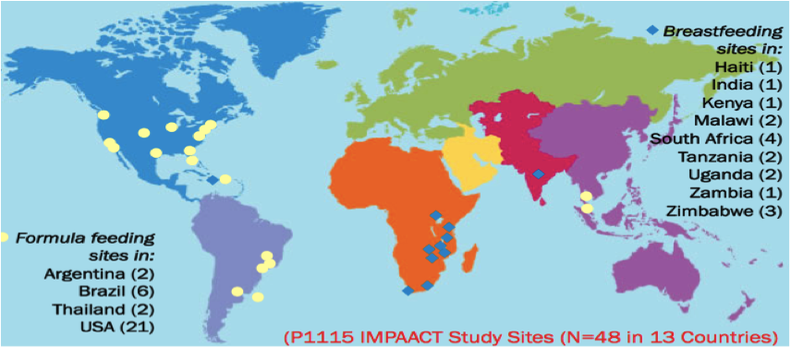
Way Forward: Post-treatment Control (ART-free Remission) Strategies for Pediatric Populations (2019)
Number | Study | Country | Intervention | Age at ART | Sample size (N) | Status
Very Early ART
1 | IMPAACT P1115 (version 1.0) | Multi-country | Very early ART | <48 hours | 440 mother-infant pairs (54-infected infants) | Closed to accrual
2 | EIT | Botswana | Very early ART | < 7 days | 20 | Enrolling
3 | LEOPARD | South Africa | Very Early ART | <48 hours | 60 | Enrolling
4 | Early treatment of Thai Infants | Thailand | Very early ART | < 6 weeks | 100 | Enrolling
Combination (Early ART + bNab)
5 | IMPAACT P1115 (Version 2.0) | Multi-country | Very early ART /Raltegravir +/- VRCO1 | <48 hours | 445 mother-infant pairs (45 infected infants) | At sites
6 | IMPAACT 2008 | Multi-country | ART +/- VRCO1 | 72 hours-12 weeks | 64 | Enrolling
7 | UO1-Trial | Botswana | ART+ combination bNabs | early ART | ? | Enrolling
Transplant CCR5--delta 32 cells
8 | IMPAACT P1107 | USA | Cord blood transplant with CCR5-delta 32 cells | NA | 20 | Enrolling N=2; 1 adult survivor
Therapeutic Vaccines
9 | HVRRICANE Study (RV534) | Europe, South Africa, Thailand | ART+ Therapeutic Vaccine | infancy and childhood | 45 | in-development

Slide 22
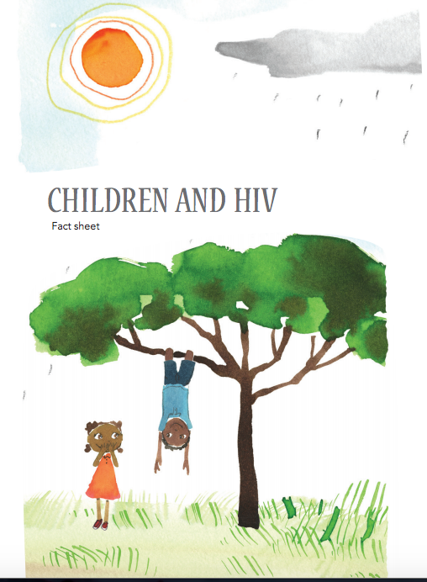
Thank you

Slide 23
Acknowledgements
IMPAACT Leadership: Sharon Nachman and James McIntyre
IMPAACT HIV Cure Scientific Committee Members
Deborah Persaud (Chair) and Ellen Chadwick (Vice-Chair)
Committee Members
Jintanat Ananworanich
William Borkowsky
Yvonne Bryson
Mark Cotton
Katherine Luzuriaga
Betsy McFarland
Steve Spector
Thor Wagner
Dan Barouch
Ann Chahroudi
Jeff Saffrit
Community Advisory Board Representatives
Sandra Boyd, Mphonda
Committee Specialists
Anne Coletti and Charlotte Perlowski
NICHD:Rohan Hazra, Eric Lorenzo
NIAID:Patrick-Jean Phillipe, Sarah Read, Judi Miller and Ellen DeCarlo
NIMH:Pim Brouwers
Biostatisticians:Camlin Tierney, Bryan Nelson, Jane Lindsey, Meredith Warshaw
IMPAACT SLG Liason:John Sleasman
New Investigators
Julie Rosebush, DO
Shaun Barnabas, MD, PhD
Samantha Fry, MD
Alka Khaitan, MD
Clinical Site Investigators
Parents, Children and Youth
Community Representatives

