Slide 1

Considerations for Designing Future Vaccine or Monoclonal Antibody HIV Prevention Efficacy Trials
Yunda Huang
Joint work with Holly Janes, Peter Gilbert
Fred Hutchinson Cancer Research Center, Seattle, USA

Slide 2
Outline
Designs of current vaccine or monoclonal antibody (mAb) efficacy trials
Designs of future vaccine or mAb efficacy trials
  Placebo-control vs. active-control
  Role of correlates of protection
Remarks

Slide 3
Ongoing HIV Prevention Efficacy Trials Evaluating
Vaccines, Monoclonal Antibodies (mAbs), or PrEP
Trial | Product | Population (Region) | End of Study*
HVTN703/HPTN081 HVTN704/HPTN085 | mAb vs. placebo | Women (Sub-Saharan Africa) MSM+TG (Americas/Europe) | 2020
* End of primary follow-up,
assuming no early stopping

Slide 4
Ongoing HIV Prevention Efficacy Trials Evaluating
Vaccines, Monoclonal Antibodies (mAbs), or PrEP
Trial | Product | Population (Region) | End of Study*
HVTN703/HPTN081 HVTN704/HPTN085 | mAb vs. placebo | Women (Sub-Saharan Africa) MSM+TG (Americas/Europe) | 2020
HVTN 702 | Vaccine A vs. placebo | Men+Women (South Africa) | 2021
HVTN 705 | Vaccine B vs. placebo | Women (Sub-Saharan Africa) | 2021
HVTN 706 | Vaccine C vs. placebo | MSM+TG (Americas/Europe) | 2023
* End of primary follow-up,
assuming no early stopping

Slide 5
Ongoing HIV Prevention Efficacy Trials Evaluating
Vaccines, Monoclonal Antibodies (mAbs), or PrEP
Trial | Product | Population (Region) | End of Study*
HVTN703/HPTN081 HVTN704/HPTN085 | mAb vs. placebo | Women (Sub-Saharan Africa) MSM+TG (Americas/Europe) | 2020
HVTN 702 | Vaccine A vs. placebo | Men+Women (South Africa) | 2021
HVTN 705 | Vaccine B vs. placebo | Women (Sub-Saharan Africa) | 2021
HVTN 706 | Vaccine C vs. placebo | MSM+TG (Americas/Europe) | 2023
PrEPVacc | Oral PrEP A vs. Oral PrEP B, Vaccine vs. placebo | Men+Women (Sub-Saharan Africa) | 2023
HPTN 083 HPTN 084 | Injectable PrEP vs. Oral PrEP B | MSM+TGW(Americas/Asia/South Africa) Women (Sub-Saharan Africa) | 2023 2024
* End of primary follow-up,
assuming no early stopping

Slide 6
Ongoing HIV Prevention Efficacy Trials Evaluating
Vaccines, Monoclonal Antibodies (mAbs), or PrEP
Trial | Product | Population (Region), Sample Size | End of Study*
HVTN703/HPTN081 HVTN704/HPTN085 | mAb: Intravenous infusion of VRC01 vs. placebo | Women (Sub-Saharan Africa), n=1924 MSM+TG (Americas/Europe), n=2701 | 2020
HVTN 702 | Vaccine: ALVAC+subtype C gp120/MF59 vs. placebo | Men+Women (South Africa), n=5406 | 2021
HVTN 705 | Vaccine: Ad26.Mos4.HIV + subtype C gp140/alum vs. placebo | Women (Sub-Saharan Africa), n=2600 | 2021
HVTN 706 | Vaccine: Ad26.Mos4.HIV + subtype C & Mosaic gp140/alum vs. placebo | MSM+TG (Americas/Europe), n=3800 | 2023
PrEPVacc | PrEP/Vaccine: oral TAF/FTC vs. TDF/FTC & DNA-HIV-PT123 + AIDSVAX B/E vs. DNA-HIV-PT123 plus CN54gp140/MPLA + MVA-CMDR/CN54gp140/MPLA vs. placebo | Men+Women (Sub-Saharan Africa), n=1688 | 2023
HPTN 083 HPTN 084 | PrEP: Injectable (cabotegravir) vs. oral (TDF-FTC) | MSM+TGW (Americas/Asia/South Africa), n=4500 Women (Sub-Saharan Africa), n=3200 | 2023 2024
* End of primary follow-up,
assuming no early stopping

Slide 7
Current HIV Vaccine (mAb) Efficacy Trial Design
Screening
HIV-negative individuals at high risk of acquiring HIV enrolled and randomized to receive vaccine (mAb) or placebo
Randomization
Placebo
Vaccine (mAb)
7

Slide 8

Current HIV Vaccine (mAb) Efficacy Trial Design
Screening
HIV-negative individuals at high risk of acquiring HIV enrolled and randomized to receive vaccine (mAb) or placebo
Standard-of-prevention package is provided to trial participants throughout the trial
Randomization
Placebo
Vaccine (mAb)
Standard Prevention Package*
*Risk reduction counseling + Biomedical Tools (PrEP, PEP, condoms, circumcision, STI testing/treatment)
8

Slide 9
Current HIV Vaccine (mAb) Efficacy Trial Design
Screening
HIV-negative individuals at high risk of acquiring HIV enrolled and randomized to receive vaccine (mAb) or placebo
Standard-of-prevention package is provided to trial participants throughout the trial
HIV infection rates compared between active vaccine (mAb) and placebo groups.
Randomization
Placebo
Vaccine (mAb)
Standard Prevention Package*
Periodic HIV Testing
Compare HIV infection rates
*Risk reduction counseling + Biomedical Tools (PrEP, PEP, condoms, circumcision, STI testing/treatment)
9

Slide 10
Outline
Designs of current Vaccine or Monoclonal Antibody HIV Prevention Efficacy Trials
Designs of future vaccine/mAb efficacy trials
  Placebo-control vs. active-control
  Role of correlates of protection
Remarks

Slide 11
Ongoing HIV Prevention Efficacy Trials Evaluating
Vaccines, Monoclonal Antibodies (mAbs), or PrEP
Trial | Product | Population (Region), Sample Size | End of Study*
HVTN703/HPTN081 HVTN704/HPTN085 | mAb: Intravenous infusion of VRC01 vs. placebo | Women (Sub-Saharan Africa), n=1924 MSM+TG (Americas/Europe), n=2701 | 2020
HVTN 702 | Vaccine: ALVAC+subtype C gp120/MF59 vs. placebo | Men+Women (South Africa), n=5406 | 2021
HVTN 705 | Vaccine: Ad26.Mos4.HIV + subtype C gp140/alum vs. placebo | Women (Sub-Saharan Africa), n=2600 | 2021
HVTN 706 | Vaccine: Ad26.Mos4.HIV + subtype C & Mosaic gp140/alum vs. placebo | MSM+TG (Americas/Europe), n=3800 | 2023
PrEPVacc | PrEP/Vaccine: oral TAF/FTC vs. TDF/FTC & DNA-HIV-PT123 + AIDSVAX B/E vs. DNA-HIV-PT123 plus CN54gp140/MPLA + MVA-CMDR/CN54gp140/MPLA vs. placebo | Men+Women (Sub-Saharan Africa), n=1688 | 2023
HPTN 083 HPTN 084 | PrEP: Injectable (cabotegravir) vs. oral (TDF-FTC) | MSM+TGW (Americas/Asia/South Africa), n=4500 Women (Sub-Saharan Africa), n=3200 | 2023 2024
* End of primary follow-up

Slide 12
Possible Design Options of Future Vaccine (mAb) Efficacy Trials Accounting for Injectable PrEP Trial Results
Two trial design options:
  Placebo-control: Randomize to vaccine (mAb) vs. placebo
    Question addressed: Absolute vaccine (mAb) prevention efficacy
  OR
  Active control: Randomize to vaccine (mAb) vs. injectable PrEP
    Question addressed: Relative/comparative prevention efficacy
In both designs, all participants have facilitated access to oral PrEP as part of the standard-of-prevention package;
In placebo-control design, all participants have facilitated access to injectable PrEP
In active-control design, only participants assigned to the active-control arm receive injectable PrEP

Slide 13
Possible Design Options of Future Vaccine (mAb) Efficacy Trials Accounting for Injectable PrEP Trial Results
Two trial design options:
  Placebo-control: Randomize to vaccine (mAb) vs. placebo
    Question addressed: Absolute vaccine (mAb) prevention efficacy
  OR
  Active control: Randomize to vaccine (mAb) vs. injectable PrEP
    Question addressed: Relative/comparative prevention efficacy
In both designs, all participants have facilitated access to oral PrEP as part of the standard-of-prevention package;
In placebo-control design, all participants have facilitated access to injectable PrEP
In active-control design, only participants assigned to the active-control arm receive injectable PrEP

Slide 14
Outline
Designs of current Vaccine or Monoclonal Antibody HIV Prevention Efficacy Trials
Designing future vaccine/mAb efficacy trials
  Placebo-control vs. active-control
  Role of correlates of protection
Remarks

Slide 15
Background: Correlates of Protection
– Iterating Towards A Highly Efficacious Preventive Vaccine
Key secondary objectives of vaccine (mAb) efficacy trials:
  Assess whether and how efficacy depends on host marker levels
Host markers in vaccine or mAb trials, e.g.,
  Vaccine: vaccine-induced neutralization or other functional responses in vaccine recipients
  mAb: serum mAb concentration or neutralization titer in mAb recipients
Prevention Efficacy
Marker Level

Slide 16
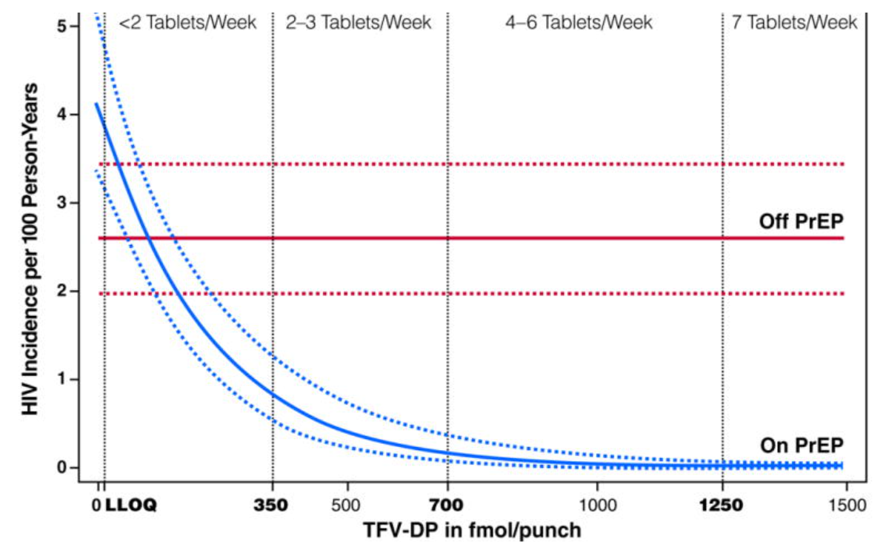
Background: Correlates of Protection
– Iterating Towards A Highly Efficacious Preventive Vaccine
Key secondary objectives of vaccine (mAb) efficacy trials:
  Assess whether and how efficacy depends on host marker levels
This is analogous to assessing how HIV incidence varies with PrEP drug level
Grant et al., Lancet ID 2014

Slide 17
Background: Correlates of Protection
– Iterating Towards A Highly Efficacious Preventive Vaccine
Key secondary objectives of vaccine (mAb) efficacy trials:
  Assess whether and how efficacy depends on host marker levels
Host markers predictive of prevention efficacy
-- Build vaccines that induce the response in more people
-- Build vaccines that induce higher levels of these responses
Prevention Efficacy
Marker Level

Slide 18
Background: Correlates of Protection
– Iterating Towards A Highly Efficacious Preventive Vaccine
Key secondary objectives of vaccine (mAb) efficacy trials:
  Assess whether and how efficacy depends on host marker levels
  Assess whether and how efficacy depends on the genotypic and phenotypic features of the breakthrough founder HIV-1 viruses
Features of the breakthrough founder HIV-1, e.g.,
  Vaccine: dissimilarity between the HIV-1 sequences in the vaccine vs. the virus
  mAb: neutralization potency of the mAb against the virus (e.g., IC₅₀)
Prevention Efficacy
Feature of the HIV-1 Virus

Slide 19
Background: Correlates of Protection
– Iterating Towards A Highly Efficacious Preventive Vaccine
Key secondary objectives of vaccine (mAb) efficacy trials:
  Assess whether and how efficacy depends on host marker levels
  Assess whether and how efficacy depends on the genotypic and phenotypic features of the breakthrough founder HIV-1 viruses
Vaccine (mAb) works against some genotypes of viruses
Build vaccines
-- that generate responses against more viruses
-- with additional HIV strains added
Prevention Efficacy
Feature of the HIV-1 Virus

Slide 20
Background: Combinations of 2 or 3 mAbs Neutralize More Viruses
If an HIV virus is targeted by multiple mAbs, then transmission may be more difficult
Greater prevention efficacy may be achieved by combinations of mAbs than single-mAbs (Wagh et al., PLOS Pathogens, 2018)
M. Seaman, BIDMC
Optimal Combinations of Broadly Neutralizing Antibodies for Prevention and Treatment of HIV-1 Clade C Infection, PLOS Pathogens, 2016

Slide 21
Role of AMP Correlates of Protection in the Design of a Sequel mAb Efficacy Trial
Trial | Product | Population (Region) | End of Primary Follow-up*
HVTN703/HPTN081 HVTN704/HPTN085 (AMP) | mAb: Intravenous infusion of VRC01 vs. placebo | Women (Sub-Saharan Africa) MSM+TG (Americas/Europe) | 2020

Slide 22
Role of AMP Correlates of Protection in the Design of a Sequel mAb Efficacy Trial
Correlates discovery provides study design rationale
  If a host marker is found predictive of efficacy (e.g., neutralization potency to circulating strains),
  then a sequel efficacy trial is scientifically supported for a new combination-
  mAb regimen that generates higher levels of that marker

Slide 23
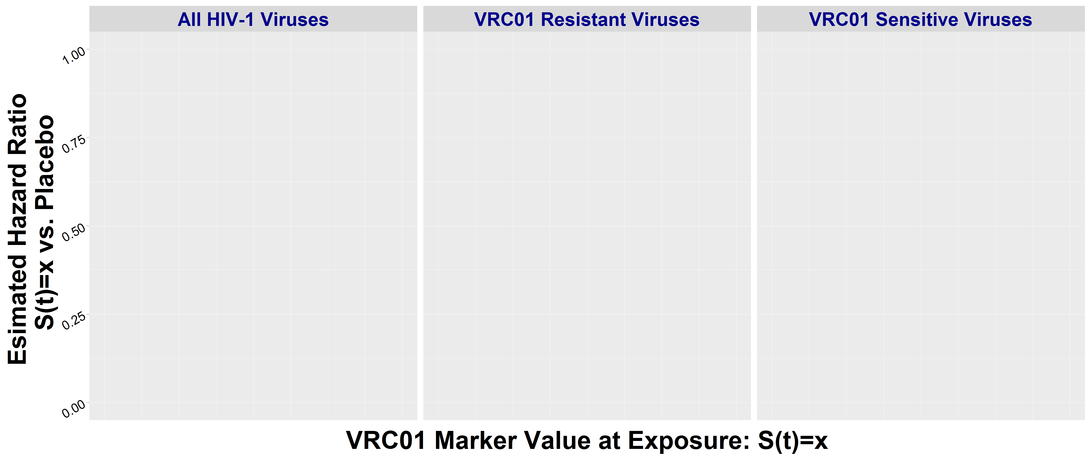
Hypothetical Scenario: AMP Prevention Efficacy Depends on VRC01 Concentration and VRC01 Neutralization Sensitivity of Exposing Viruses
PE = 80%
Prevention Efficacy
PE = 40%
PE = 0 %
VRC01 Concentration at Exposure

Slide 24
Hypothetical Scenario: AMP Prevention Efficacy Depends on VRC01 Concentration and VRC01 Neutralization Sensitivity of Exposing Viruses
PE = 80%
Prevention Efficacy
PE = 40%
PE = 0 %
VRC01 Concentration at Exposure

Slide 25
Hypothetical Scenario: AMP Prevention Efficacy Depends on VRC01 Concentration and VRC01 Neutralization Sensitivity of Exposing Viruses
Clear path to a sequel combination or multi-specific mAb prevention efficacy trial
  Regimens with greater neutralization potency & breadth are predicted to have greater prevention efficacy
Placebo-control design is a favored option given,
  Moderate overall PE of VRC01
  VRC01 is not being developed as a product on its own
  with facilitated access to injectable PrEP as part of the standard-of-prevention package for both mAb and placebo recipients

Slide 26
Hypothetical Scenario: AMP Prevention Efficacy Depends on VRC01 Concentration and VRC01 Neutralization Sensitivity of Exposing Viruses
Clear path to a sequel cocktail or multi-specific mAb prevention efficacy trial
Two potential placebo-control designs with facilitated access to injectable PrEP as part of the standard-of-prevention package for all participants
  2-mAb vs. 3-mAb vs. placebo
    Co-primary objectives to assess PE of each active regimen vs. placebo and to compare PE
    Supplies more data for validating a neutralization marker surrogate
  3-mAb vs. placebo

Slide 27
Role of AMP Correlates of Protection in the Design of a Sequel mAb Efficacy Trial (Cont.)
Correlates discovery provides study design rationale
Correlates results support study design specifics: study population and sample size
  If a host marker is found predictive of efficacy (e.g., neutralization potency to circulating strains)
  Predict prevention efficacy based on the observed marker values for future combination-mAb regimens
  Sample size/power of the combination-mAb trial can be planned

Slide 28
Role of AMP Correlates of Protection in the Design of a Sequel mAb Efficacy Trial (Cont.)
Correlates discovery provides study design rationale
Correlates results support study design specifics: study population and sample size
  Provides estimates of the possible achievable prevention efficacy of the future combination-mAb regimen
  If a certain genotypic/phenotypic feature of the viruses is found predictive of efficacy in AMP
    Predict prevention efficacy based on the target circulating HIV strains

Slide 29
Role of AMP Correlates of Protection in the Design of a Sequel mAb Efficacy Trial (Cont.)
Correlates discovery provides study design rationale
Correlates results support study design specifics: study population and sample size
  Provides estimates of the possible achievable prevention efficacy of the future combination-mAb regimen
  If a certain genotypic/phenotypic feature of the viruses is found predictive of efficacy in AMP
    Predict prevention efficacy based on the target circulating HIV strains
    Select study population depending on study objectives – maximize the feature or overall coverage

Slide 30
Designing Future HIV Vaccine (mAb) Prevention Efficacy Trials
HIV prevention landscape will evolve over next few years
Success in HIV prevention poses new challenges- and new opportunities for engagement and collaboration
Optimizing trial design requires collaborative discussions to identify populations most in need and highest priority scientific questions- to maximize scientific insights and rigor
Analyses investigating correlates of protection in ongoing trials will have major influence on the design of future vaccine or mAb prevention efficacy trials

Slide 31
References
November, 2018 symposium, HIV Vaccine Efficacy Trial Designs of the Future (http://www.hvtn.org/en/about/hvtn-conferences/hiv-prevention-efficacy-trials-design-of-the-future.html)
Huang Y, Karuna S, Carpp LN, Reeves D, Pegu A, Seaton K, Mayer K, Schiffer J, Mascola J, Gilbert PB. “Modeling cumulative overall prevention efficacy for the VRC01 phase 2b efficacy trials.” Hum Vaccin Immunother. 2018;14(9):2116-2127.
Gilbert PB, Zhang Y, Rudnicki E, Huang Y. “Assessing pharmacokinetic marker correlates of outcome, with application to antibody prevention efficacy trials.” 2019 Jul 17. doi:10.1002/sim.8310. [Epub ahead of print]
Janes H, Donnell D, Gilbert PB, Brown ER, Nason M. “Taking stock of the present and looking ahead: envisioning challenges in the design of future HIV prevention efficacy trials.” Lancet HIV. 2019 Jul;6(7):e475-e482. Epub 2019 May 8.
Gilbert PB. “Ongoing Vaccine and Monoclonal Antibody HIV Prevention Efficacy Trials and Considerations for Sequel Efficacy Trial Designs.” Stat Comm in Infectious Diseases. In Press.
Notes:
This is a select list of references that provide more background and details of the points if you are interested.

Slide 32

Thank You
This work was supported by the National Institute of Allergy and Infectious Diseases (NIAID) US. Public Health Service Grant
UM1 AI068635 [HVTN SDMC FHCRC].

