Slide 1
Virologic Failure In ART-Naive HIV Patients With High Pre-Therapy Viral Load Burden Initiating On Common Core Agents
Anthony M. Mills, M.D.
Men’s Health Foundation, Los Angeles, CA
#MENSHEALTHFOUND

Slide 2
Disclosures
Anthony Mills has received research funding from Gilead Sciences, ViiV Healthcare, Janssen, Merck and Sangamo
He is on advisory boards for Gilead Sciences, ViiV Healthcare, Janssen & Merck

Slide 3
Background
Previous work has suggested that a sizeable proportion of naïve patients present with baseline VL ≥ 100K copies/mL (Mills, ISPOR 2019)
Achieving virologic suppression in these patients can be challenging (DiBiagio, 2014; Raffi, 2017)
Notes:
Kathy Shulman ISPOR 2019

Slide 4
Objective
We assessed the effectiveness of dolutegravir (DTG), elvitegravir (EVG), raltegravir (RAL) and darunavir (DRV) on rates of virologic failure (VF) in antiretroviral (ART) naïve patients initiating therapy with a high viral load burden (≥ 100,000 copies/mL) in a real world setting

Slide 5
METHODS

Slide 6
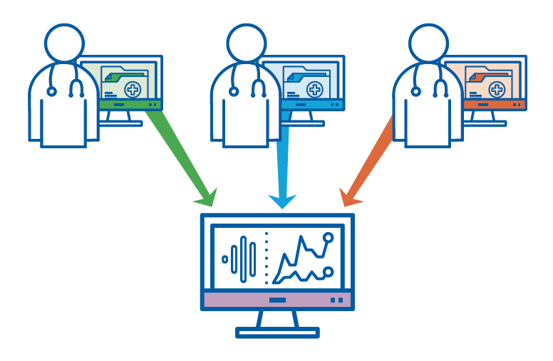
Study Population: Data Source
Observational Pharmaco-Epidemiology Research & Analysis (OPERA) cohort
Prospectively captured, routine clinical data from electronic health records
Notes:
OPERA-participating clinicians documented the care of almost 1,000,000 patients in their EHRs
104K HIV+ patients of which 19% are women, representing 7 percent of all the HIV+ patients diagnosed in the U.S.
Average years of follow-up for HIV+ patients in OPERA is 4.3 years
13K HIV+ patients have ten years or more of follow-up

Slide 7
U.S. Map of OPERA & CDC, HIV+ Population
100,000+ Patients
65 Cities
19 States
1 US Territory
Notes:
the darker the shading, the higher the CDC reported rates of HIV diagnosis in that state
the larger the red circle, the bigger the OPERA site.

Slide 8
Study Design
Eligibility Criteria
HIV-positive
≥ 13 years of age
ART naïve, prescribed DTG, EVG, RAL or DRV by an OPERA caregiver
Baseline viral load ≥100,000 copies/mL
Eligibility period
August 12, 2013 to July 31, 2017
Follow-up through July 31, 2018
Baseline
Date of core agent initiation
Notes:
These 4 core agents were used in combination with 2 NRTIs

Slide 9
Definition of Virologic Failure
VL ≥200
VL ≥200
A
Never Achieved Virologic Suppression
VL ≥200
B
VL ≥200
VL ≥200
C
Achieved & Lost Virologic Suppression
VL ≥200
D
ART initiation
36 weeks
Viral load >50 copies/mL
VL ≥200
Viral load ≥200 copies/mL
Viral load ≤50 copies/mL
Core agent discontinuation
Notes:
Blue line indicates time where VL>50 copies/mL.
Four VF definitions
A: 2 consecutive VLs ≥200 copies/mL after 36 weeks of ART, or
B: 1 VL ≥200 copies/mL with core agent discontinuation after 36 weeks, or
C: 2 consecutive VL ≥200 copies/mL after suppression (VL ≤50 copies/mL) before 36 weeks, or
D: 1 VL ≥20 copies/mL with discontinuation after suppression before 36 weeks.

Slide 10
Analyses
Unadjusted and adjusted cumulative virologic failure probability
Kaplan Meier methods
Multivariate Cox Proportional Hazards model
Adjustment set: All covariates measured at baseline
Age
Sex
Race
CD4 cell count
HIV RNA VL
History of AIDS
VACS score
Drug abuse
History of syphilis infection
Calendar year of ART initiation
Route of infection
Type of healthcare coverage
Notes:
Veterans Aging Cohort Study- associated with dependence in one or more activities of daily living(³⁷). It responds to important changes in health and health behaviors: VACSIndex scores change in response to antiretroviral initiation³⁸ and interruption⁷, and discriminate among levels of ART adherence³⁸.
Veterans Aging Cohort Study Index (VACS Index) creates a score by summing pre-assigned points for age, routinely monitored indicators of HIV disease (CD4 count and HIV-1 RNA), and general indicators of organ system injury including hemoglobin, platelets, aspartate and alanine transaminase (AST and ALT), creatinine, and viral hepatitis C infection (HCV) (Table 1)¹. This score is weighted to indicate increasing risk of all-cause mortality with increasing score. The score can be used to estimate risk of all-cause mortality using a conversion factor². A calculator, summary of validation work to date, and a clinical interpretation of VACS Index scores can be found above.

Slide 11
RESULTS

Slide 12
Study Population: Individuals with Baseline VL ≥ 100,000 copies/mL (N=2,038)
DRV
n=326, 16%
Notes:
Most (82%) are initiating on DTG or EVG
Few RAL initiators

Slide 13
Baseline Demographic Characteristics
*Result is statistically significant (p<.05) compared to DTG
Notes:
EVG and DTG were similar. The only significant differences are not shown on this slide. EVG initiators were more likely to receive care in the southern United States (p<.001). Conversely, they were less likely than DTG initiators to receive care in the western US (p<.001) or to have Medicaid (p<.05).
RAL users were older (p<.05) with median (IQR) age of 40 (29-48) as compared to DTG users at 33 (26-43). They were more likely to be female (31%, p<.01) and less likely to be MSM (p<.01).
Compared to DTG users, DRV users were older (median: 37 [IQR: 29, 45] p<.001), more likely to be African American (p<.05), or to have Medicare (p<.05), and less likely to have a commercial payer (p<.01) .

Slide 14
Baseline Clinical Characteristics
*Result is statistically significant (p<.05) compared to DTG
Notes:
EVG and DTG were similar in their clinical characteristics at baseline.
RAL and DRV users were the smallest groups and had higher baseline viral loads (DRV p<.0001) and lower baseline CD4 cell counts (RAL p <.05 & DRV p<.0001) than did DTG initiators. They were also more likely to have a baseline history of AIDS (DRV p<.0001), a higher VACS score (RAL p<.05 & DRV p<.0001), and more non-ART prescriptions (p<.05) than DTG users.

Slide 15
≥ 100,000 copies/mL Achieved Virologic Suppression by 36 Weeks, Unadjusted
Notes:
Not a clinical trial so patient must have a second visit within 36 weeks with VL test to be in the denominator.

Slide 16
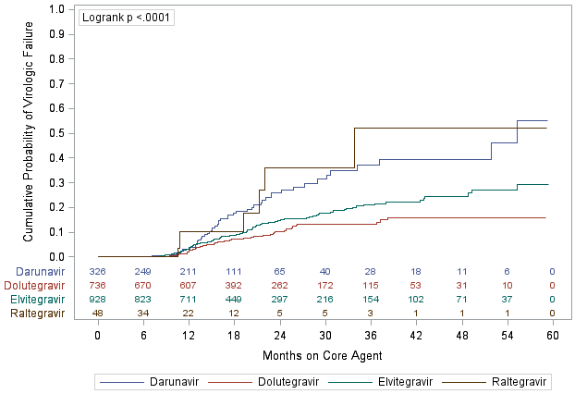
Unadjusted Cumulative Probability of Virologic Failure in Individuals with Baseline VL ≥ 100,000 copies/mL
DRV
RAL
EVG
DTG
Notes:
In these Kaplan-Meier curves, there were significant differences in the probability of virologic failure across these four groups before adjustment. However, the RAL group was very small and the DRV group was very different from the DTG and EVG groups.

Slide 17
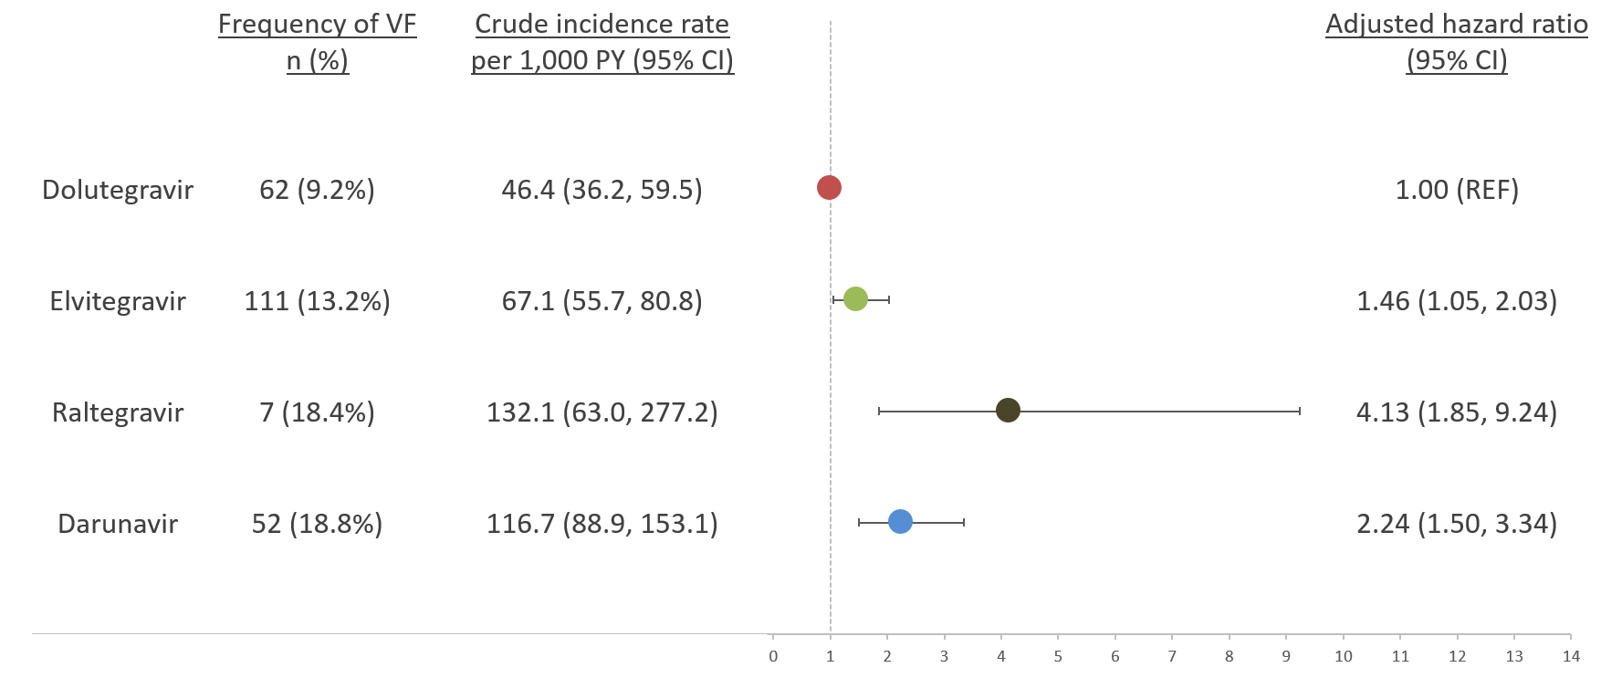
Association Between Core Agent and Virologic Failure in Individuals with Baseline VL ≥ 100,000 copies/mL
Notes:
In this figure, we show the crude frequency and incidence rate per 1,000 person-years with 95% confidence intervals for each group.
Cox proportional hazard models were adjusted for baseline age, sex, race, CD4 cell count, HIV RNA VL, history of AIDS, VACS score, drug abuse, history of syphilis infection, calendar year of ART initiation, route of infection and type of health coverage.
In this population of patients with high viral loads at treatment initiation; EVG (1.46 [1.05, 2.03]), RAL (4.13 [1.85, 9.24]), and DRV (2.24 [1.50, 3.34]) were all associated with virologic failure.
203 patients were excluded from modeling because a VACS score could not be calculated. These included 61 non-failures and 5 failures on DTG, 91 non-failures and 11 failures on EVG, 5 non-failures and 0 failures on RAL, and 29 non-failures and 1 failure on DRV.

Slide 18
DISCUSSION

Slide 19
Key Findings
ART-naïve patients with high viral loads initiating on DTG were significantly less likely to experience VF compared to EVG, RAL and DRV initiators even after adjusting for differences in baseline characteristics

Slide 20
Strengths
Limitations
Large sample size in each of the treatment groups with the exception of raltegravir
OPERA cohort is a representative sample of the HIV population receiving care in the United States
Approximately 7% of all US patients active in care are represented in the database
Electronic medical records:
Availability of lab results
Ability to identify and account for history of disorders
Small sample size in raltegravir group
Darunavir patients differed notably, especially on baseline characteristics associated with risk for treatment failure
OPERA clinical data is collected at point-of-care and is subject to the record-keeping practices of each healthcare provider and each clinic
The latest DHHS recommended agent, bictegravir, and new formulations of raltegravir and darunavir were not included in this study as their approval occurred after the close of study eligibility

Slide 21
Acknowledgements
This research would not be possible without the participation of people living with HIV and their caregivers
Co-authors: Kathy Schulman, Jennifer Fusco, Michael Wohlfeiler, Julie Priest, Alan Oglesby, Laurence Brunet, Phil Lackey, Gregory Fusco
I am grateful for the following contributions: Amelito Torres (SAS programming), Jeff Briney (QA/QC), Rodney Mood (site selection and support), Ted Ising (database architecture and support), Bernie Stooks and Redemptor Perez (database support) and Judy Johnson (medical terminology classification)
This research was supported by ViiV Healthcare

Slide 22
BACK-UP SLIDES

Slide 23
Virologic Failures After Excluding 203 Patients Without Baseline VACS Index for Modeling
 | N | # failures | %
DTG | 670 | 57 | 8.5
EVG | 826 | 100 | 12.1
RAL | 43 | 7 | 16.3
DRV | 296 | 51 | 17.2
Total | 1,835 | 215 | 11.7
Notes:
203 patients were excluded from modeling because a VACS score could not be calculated. These included 61 non-failures and 5 failures on DTG, 91 non-failures and 11 failures on EVG, 5 non-failures and 0 failures on RAL, and 29 non-failures and 1 failure on DRV.

Slide 24
COX MODEL RESULTS
Notes:
VACS is a mortality index that predicts the 5-year risk of mortality.
Year of ART initiation represents the addition of new OPERA clinics that were more likely to be public or non-profit clinics with more patients with low SES
ADAP/Ryan White/Medicaid/Medicare represent patients on government assistance for their HIV care.

