Slide 1








Using evidence to influence programs: Sauti Project experience
Transforming Evidence into HIV Policies and Practice:
Lessons from the Field
Project SOAR Technical Advisory Meeting
Thursday, 30 May 2019
Washington DC, USA
Kelly Curran
Sr. Director, HIV and Infectious Diseases
Jhpiego
Notes:
Sauti’s – SOAR collaboration:
Differentiated Care for PLHIVs (particularly KPs) encourages “ART Initiation & Refills” at community level
Prior to Sauti-SOAR collaboration, all newly diagnosed PLHIVs (by Sauti in the community) were linked (actively by escorted referrals or passively through self referrals) to GoT CTC; Community ART wasn’t a policy yet
PC designed and piloted the delivery of community-based antiretroviral therapy (ART) services to female sex workers (FSWs) using community-based HTC platforms (mobile and home-based provided by Sauti project).
It was hypothesized that positive FSWs receiving community-based ART will have higher rates of ART initiation, retention, and viral suppression
Sauti (a combination prevention program for KVPs) provided PC/SOAR for implementing this study
Key Point to highlight:
Throughout all phases of implementation of this study, Sauti collaborated with PC/SOAR Project to not only use findings from the study to advocate for policy change (to enable us implement as per COP guidance), but also more importantly we used the findings to inform the refining/retuning the implementation of Comm Outreach ART services within the project’s service delivery platform (in accordance with the national guidelines/recommendations of the time)

Slide 2
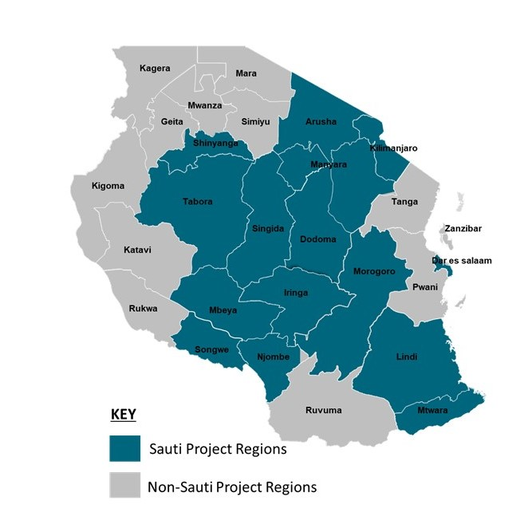
BACKGROUND
Sauti Project in Tanzania
GOAL: Contribute to improved health for all Tanzanians through sustained reduction in new HIV infections
Provides biomedical, behavioral and structural prevention, HIV Testing & Linkage, and family planning to key and vulnerable populations (KVPs)
  Female sex workers & their sexual partners
  Men who have sex with men
  Adolescent girls and young women
  Other at risk populations living in hotspots
  Children of KVP & PLHIV
Worked in 15 regions with high HIV burden
From August 2015 – April 2019: Tested for HIV 2.6 Million and Diagnosed more than 127,000
Sauti is required to ensure all newly diagnosed PLHIVs are linked to care & treatment (recently asked to facilitate ART initiation in collaboration with facility IPs)
Notes:
Project Overview:
Sauti means “voice” in Kiswahili. The project name was chosen to indicate our efforts to help voice the needs of those Tanzanians most marginalized and at highest risk of HIV infection: key populations, adolescent girls and young women, and mobile men/clients of sex workers).
Since its inception, Sauti has worked in a total of 15 regions (exited in 4 because of changed PEPFAR priorities)
As of to date, the project tested 2.6M individuals, and diagnosed 127K new PLHIVs; and confirmed linkage of 91K of the newly diagnosed PLHIVs

Slide 3
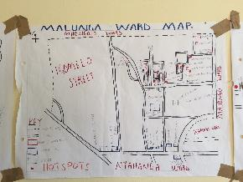

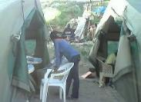
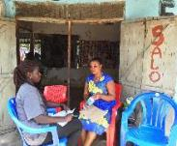

Sauti’s Service Delivery Model
Behavior change education
Saving and Loaning Services
Biomed venues
Tent
Rented room in brothel, bars, etc.
Workplace
Private residence
Saving/Loaning, SBCC venues
School
Govt office
Private residence
Hot Spot Mapping by Community Based HIV Service Providers (peer educators)
Individual peer to peer
Job aides
IEC material
Social Media (WhatsApp)
Testimonials (FP)
Biomedical services
Bar, night clubs
Brothels, guest houses
Fishing villages
Mining communities
Plantations
Truck / taxi drivers parking
HTS-FP
Escorted referral to CTC
Screening STI-TB-GBV
Services are provided day and night, from Monday to Saturday
Notes:
Sauti’s Service Delivery Approach (Original Approach Prior to Startup of Community ART)
Sauti project offers combination prevention services at hotspots in the community
Such hotspots are mapped by trained peer educators who create demand for the combination prevention services and directly offer SBCC education, promote and distribute condoms and IEC material, network through social media and offer testimonials about HIV prevention services
Saving and loaning services are offered in the context of DREAMS and to AGYW only
Biomedical services are for all beneficiaries and include HTS-FP, screening for STI and FP and GBV, as well escorted referral to CTC
Services are offered at a variety of venues, from brothels to mining sites, under a tent or in rented rooms in guest houses/bars/local government offices and at private residences
Services are available day and night from Monday to Saturday
Link to slide #4:
In addition to linking clients via escorted referrals and also ensuring those clients that self-refer are truly linked, Sauti’s role is to facilitate and advocate for the changes in policy (MOH to embrace differentiated models for ART care);
The next slide shows what has been the practice depending on the allowable policies of the time

Slide 4



Practices for ART Initiation & Refilling within the Sauti Platform
FY15
(Feb 15 – Sept 15)
FY16
(Oct 15 –Sept 16)
FY17
(Oct 16 – Sept 17)
FY18
(Oct 17 – Sept 18)
FY19
(Oct 18 – Sept 19)
Differentiated ART Linkage/Treatment Approaches | | ------------------------------------Sauti Practices in Conformance with National Policies/Guidelines---------------------------------|
Community Testing followed by Active & Passive Linkage
Community ART Refills/Outreach (Stable Clients) – Trained Provider
Community ART Refills (Stable Clients) – Lay Workers/Peers*
Community ART Initiation & Refills (KVPs)
Community Initiation & Refills (General Population)
---
---
---
---
---
---
---
---
---
---
SOAR FSW Comm ART Study (Initiation & refills in the community by trained Providers) | ----- |  | ------
*With the introduction of multi-month scripting, peer-led community ART refills are no longer a priority

Slide 5


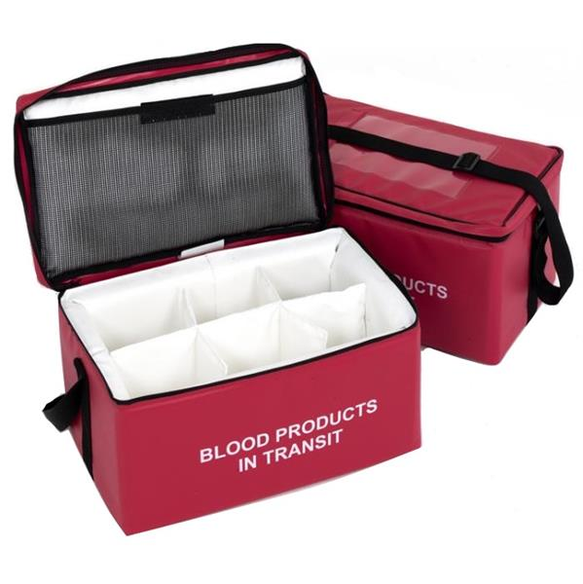

SOAR Study: Community-Based ART Initiation for FSW
in the Sauti Service Delivery Platform
Community
Government
Health Facility
Sauti peer educators mobilize FSW to access HTS and community ART
Care and Treatment Clinic (CTC)
Community-based service (eg. ghettos, residence)
Sample transportation
Hematology
Biochemistry
CD4/Viral Load
ART service by nurse and clinician
Laboratory
M&E room
Data Manager bring reports to “mother” CTC
Pharmacy
Every 3 months: health care provider carries ARV, INH meds, M&E tools
Peer educator conducts monthly ART adherence counselling, reminds about clinical appointments, escorts back to CTC those clients in need
Notes:
Methods:
This is a mixed-method implementation science study, using a quasi-experimental design.
A cohort of 617 HIV-positive FSWs not currently on ART was established (June-July, 2017) and is being followed up (309 in Njombe; 308 in Mbeya).
Participants in the intervention arm (Njombe region) were enrolled into mobile and home-based ART, counselled on ART, and immediately received a one-month supply of antiretroviral (ARV) drugs.
At the first refill, each FSW receives a 2-month drug supply. Subsequently, FSWs receive a 3-month supply. FSWs in the comparison arm (Mbeya region) were referred to public ART facilities following national guidelines (1-month supply, at designated facilities, by appointment).
Qualitative semi-structured interviews with 8 FSWs were conducted at 3 months after intervention implementation in Njombe to understand successes and challenges of the intervention strategy.
We extracted data on ARV refills and missed appointments from Sauti’s community-based ART program patient records.
We collected data at baseline and will re-interview the cohort at 6 and 12 months.
Study Implementation:
This slide illustrate the community-based ART service to FSW which was nested over Sauti services
The recruitment was mainly carried out through Sauti mobile and homebased testing events.
Trained peer educators mobilized the FSW to access HTS and community-based ART initiation
Trained nurses and clinicians offered clinical service every 3 months at the FSWs’ preferred venue, often their ghettos and residence
M&E tools and ARV medications were shuttled up and down the mother/reference CTC when community ART service was taking place; as well blood specimens for hematology, biochemistry and HVL; lab test was done at the lab of the mother/reference CTC
National guidelines and standards as well M&E tool and system were followed to offer community-based ART; the venue was the only difference when compared to facility-based ART service
The service delivery model was agreed upon with the local government authorities at national, regional and district level and was among the outcomes of the various meetings that took place prior the roll out of the service
This study was completed in December 2018

Slide 6
SOAR STUDY FINDINGS & EXPERIENCES DURING & AFTER THE STUDY PERIOD
Cascade of Enrolled FSWs
Excellent buy in by local government authorities (LGAs) and GoT CTC healthcare providers
  Njombe LGAs requested an extension of the study to FSW sexual partners and children
High acceptability of community ART services by FSW members
High retention (97% of all initiated clients completed the 9th month visit)
Systems for sample transportation (for lab testing) and ART supply chain worked well (improvements needed)
Clinical Retention of Enrolled FSW
Notes:
This slide has two graphs
Graph #1: Showing the cascade of study clients
Graph #2: Illustrates the fllowing
Description of return visits to clinic for FSW under study at 1, 3, 6, and 9 months, which was as high as 96% for the latter time period
Note: Though not included, lab test coverage was moderate ranging from 70% to 80%, and it was mostly due to chronic shortage of lab reagents from the national supply system; three quarters received a HVL test and only half had HVL test result – a situation of which was contributed by chronic lab reagents shortage but also high turnaround time (TAT) of the test which was done in a regional hospital in another region; and relatively low HVL suppression ≤ 1,000 (60%)

Slide 7
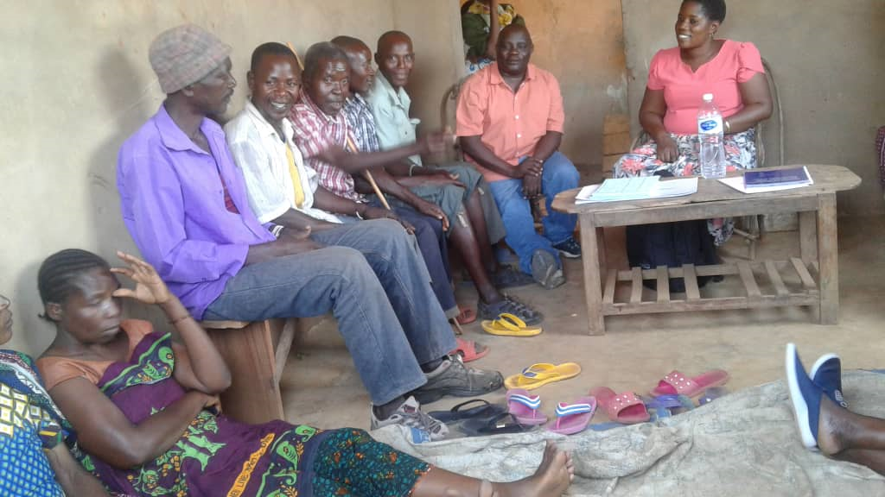
SOAR – Sauti collaboration improved project staff’s capacity and systems for delivering community/outreach ART to stable clients
  10,226 stable HIV clients currently receiving ART refills at community level (Sauti-led)
Notes:
Following the regular updates to NACP/MOH about the successful retention rates from SOAR study, NACP felt comfortable to issue a new policy for provision of ART outreach services to stable clients; and so, I would move this slide before slide 7

Slide 8
TRANSITIONING STUDY CLIENTS TO COMMUNITY ART OUTREACH
48 non-Sauti SNU by end of the study
20 got pregnant
37 had higher HVL (>=1000)
31 Moved out from study SNUs
16 waiting for HVL results
1 had TB

Slide 9

FINDINGS FROM SOAR STUDY CONTRIBUTED TO ART POLICY CHANGES
FY15
(Feb 15 – Sept 15)
FY16
(Oct 15 –Sept 16)
FY17
(Oct 16 – Sept 17)
FY18
(Oct 17 – Sept 18)
FY19
(Oct 18 – Sept 19)
Differentiated ART Linkage/Treatment Approaches | | ------------------------------------Sauti Practices in Conformance with National Policies/Guidelines---------------------------------|
Community Testing followed by Active & Passive Linkage
Community ART Refills/Outreavh (Stable Clients) – Trained Provider
Community ART Refills (Stable Clients) – Lay Workers/Peers
Community ART Initiation & Refills (KVPs)
Community Initiation & Refills (General Population)
New
New
New
Under discussion
SOAR FSW Comm ART Study (Initiation & refills in the community by trained Providers) | ----- |  | ------
*With the introduction of multi-month scripting, peer-led community ART refills are no longer a priority
Notes:
This slide shows the newer policies that have been changed recently
SOAR can’t be fully attributed; but of course significantly contributed (as far as we are concerned)
Not included in this slides; Sauti advocated for the change in various barriers of HIV programming at the parliament (Parliamentary Committee for HIV and Drugs)

Slide 10

SOAR’S CONTRIBUTION TO COMMUNITY ART PROGRAMMING & POLICY CHANGE
1. SOAR research study findings and implementation experiences
2. Shared/disseminated implementation progress with MOH, local govt, and other stakeholders
4. Developed/refined Sauti’s Comm ART SOPs, training package/ curricula, checklists, and M&E tools
3. Trained Comm ART providers, intensified mentorship and supervision, strengthened QI systems
5. Used findings from the SOAR research and Sauti Comm ART program learnings to further improve programming & influence policy change
6. Continuous strengthening of differentiated ART service delivery approaches & refine learning agenda
Notes:
This slide is self explanatory
SOAR study findings and experiences were constantly used by Sauti to engage various stakeholders (GoT, LGAs, USAID, other IPs, the parliamentary committee for HIV and Drugs, etc.) to advocate for the fast tracking of ART delivery

Slide 11

EXAMPLE: RECENT POLICY CHANGE TO ALLOW FACILITY–LED COMMUNITY
INITIATION OF ART FOR KEY AND VULNERABLE POPULATIONS
And two years later MOH issued an official circular
Notes:
As result of the lessons learnt and the success of the community ART service, two years later (very recently), MOH issued a circular authorizing community-based ART initiation to KVP

Slide 12
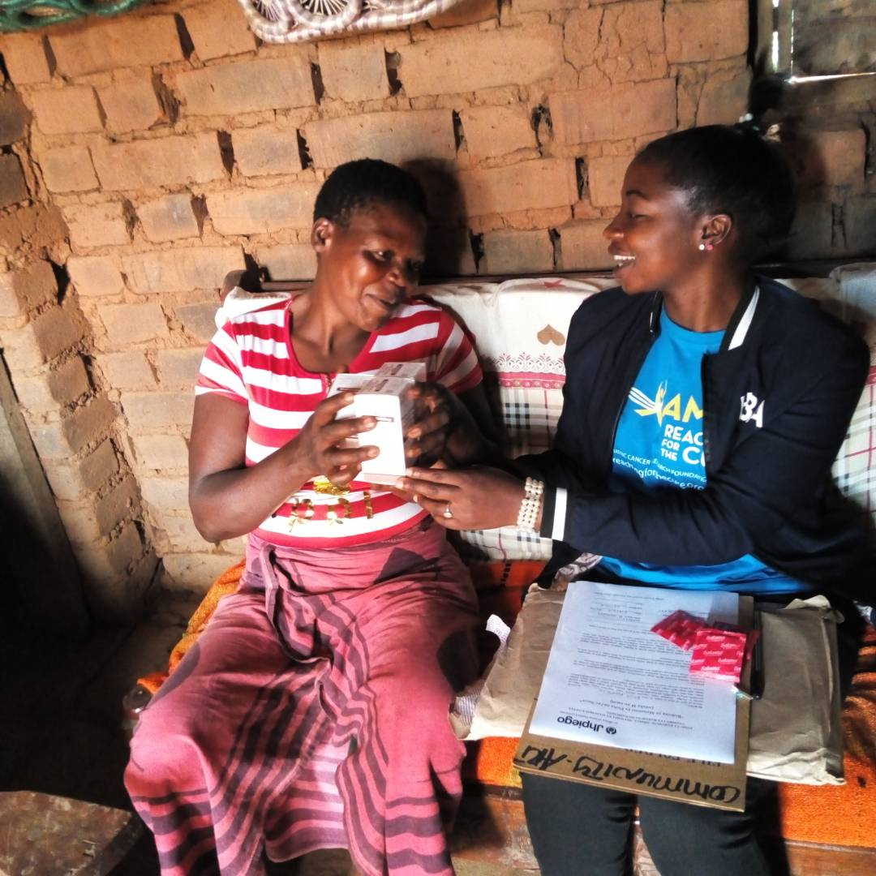
LESSONS LEARNED
Implementation science research (which is aligned with country priorities) plays a pivotal role in the development of context-specific public health solutions
Meaningful engagement of all key stakeholders at all stages increases ownership, and is key to quicker translation of research evidence to both policy change and practice
  MOH technical staff were included as
  Co-PIs of the research study
  Local Govts were engaged in implementation
  A Research Advisory Committee was a platform for gathering stakeholders’ insights
  Sauti project team was engaged in all stages of the study
Need better strategies for improving ART adherence and addressing stigma

