Slide 1
Global Men’s Health and Rights Survey
George Ayala, PsyD
MPact Global Action for Gay Men’s Health and Rights, Oakland, California, U.S.
AIDS2019, Mexico City, Mexico

Slide 2
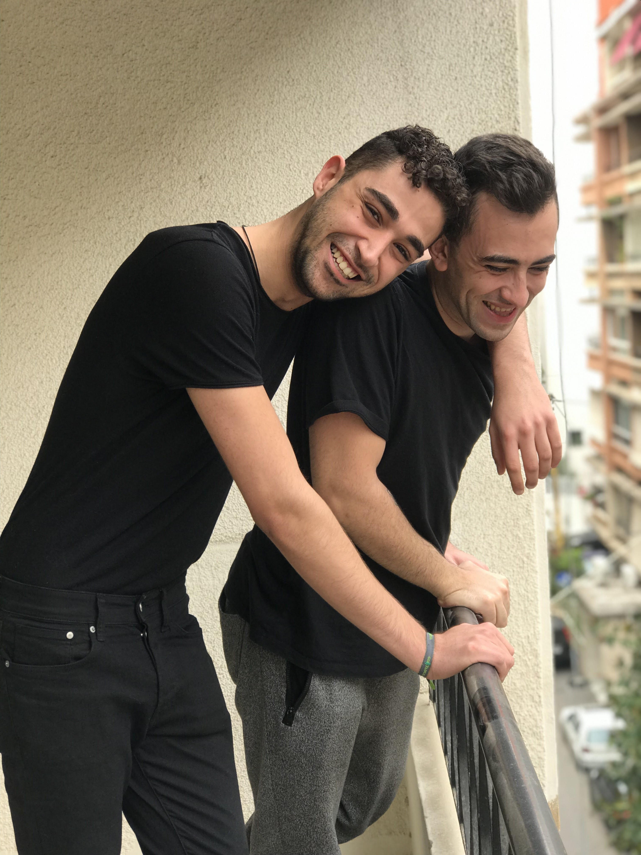
Talk Overview
What is GMHR
Why MPact conducts online surveys
Methods used
Community-based participatory action research
What we’ve learned
How we use findings
Acknowledgement and thanks

Slide 3
Global Men’s Health and Rights Survey
International, multilingual, online survey
Structural facilitators of/barriers to service access and utilization
General trends in gay/bi men’s sexual health more broadly
Rapid turnaround of study results
Regional and sub-group analyses
Galvanizing effect
15,000 respondents from nearly 200 countries
 | GMHR 1 | GMHR 2 | GMHR 3*
Year Conducted | 2010 | 2012 | 2014
Sample Size | 5,002 | 5,784 | 4,777
No. of Countries Sampled | 37 | 160 | 136
Percent from Global South | 30% | 28% | 60%
Percent from Global North | 70% | 72% | 40%
*Baseline only (i.e., exclusive of 6-month and 12-month follow-up data)

Slide 4
Why MPact Conducts GMHR
Gay and bisexual men, and other men who have sex with men shoulder disproportionate HIV disease burden in all parts of the world
We are criminalized, stigmatized, and experience high rates of discrimination and violence
Service needs of our communities are not yet universally understood and addressed
Unequal burden for community-led organizations to make a case for targeted, evidence-informed, rights based services and funding

Slide 5
“…it will be important to find some way to evade the choice between the rational subject and the pathological subject, as well as some way to take the drama out of the practice of risk. To do that, we may need to move HIV/AIDS away from the center of all thinking about gay men’s sexual health.”
–David Halperin ​

Slide 6
Approach
Community-based participatory action research:
Challenges traditional power relations
Research in service of our communities
Iterative
Sex, sexual orientation, sexual health, and rights affirming

Slide 7
Principles
Recognizes community as important to both identity and behavior; ​
Builds on strengths & resources within community; ​
Facilitates collaborative, equitable partnership in all phases; ​
Fosters co-learning & capacity building; ​
Integrates balance between knowledge generation & intervention for mutual benefit of all partners; ​
Focuses on local relevance using ecologic perspectives to understand multiple determinants of health; ​
Involves systems development w/ cyclical & iterative process; ​
Disseminates results to all partners & involves all in process; ​
Involves a long-term process & commitment to sustainability. ​

Slide 8
Methods Used
Identification of major domains
Scale development – qualitative interviews, feedback from previous online surveys, standardized scales used in other studies with gay/bi men
Iteratively revised based on external reviews
20-30-minute online survey – based on the expressed priorities of community members
Multilingual – (2014) Arabic, Chinese, English, French, Portuguese, Russian, and Spanish
Community-led quality assurance and validation processes of survey
Beta tested online questionnaire

Slide 9
Methods Used
Reliability testing of scales across languages
MPact networks, listservs, e-mail, website, social media, apps
Fitted GEE logistic regression models with robust standard errors
Accounted for clustering by country
Participatory discussion of findings
Community reports, tech briefs
Conference presentations
Peer review journal publications

Slide 10
Survey Domains
Access/Utilization
Individual & Structural Factors
Condoms​
Lubricants​
HIV-testing​
HIV treatment​
STI testing and treatment
Substance use services
Mental health services
PrEP (knowledge, access​/utilization)
Mode of service delivery
Emerging developments – self-testing, injectables, etc.
Demographics
Homophobia
Violence
Stigma
Discrimination
Community engagement
Connection to gay community
Comfort with provider
Quality of Life (WHO - physical, psychological, social relationships, environment)

Slide 11
What We’ve Learned
Structural violence is having a negative impact on quality of life
Challenges accessing and utilizing sexual health services are persistent
Easier for global northerners, older men, and men with financial means
Community engagement moderates the negative impacts of structural violence
Men are open to know more, but…
intervention acceptance is dependent on how concerns are addressed

Slide 12
What We’ve Learned
Criminalization
Funding
Homophobic discrimination, violence
Provider stigma
Access
Utilization
Wellness
Community
connectedness
support
-led services

Slide 13
How We Use GMHR Findings
Influence policies and practices
Inform national AIDS planning processes
Tailor program design and implementation
Advocate for increased funding
Set monitoring standards for advocates

Slide 14
Peer Reviewed Publications
Flores JM, Santos GM, Makofane K, Arreola S, Ayala G. Availability and use of substance abuse treatment programs among substance-using men who have sex with men worldwide. Substance Use & Misuse. 2017; 52(5): 666-673. DOI: 10.1080/10826084.2016. 1253744.
Santos GM, Makofane K, Arreola S, Do T, Ayala G. Reductions in access to HIV prevention and care services associated with arrest and conviction in a global survey of men who have sex with men. Sexually Transmitted Diseases. 2017. 93(1): 62-64. DOI: 10.1136/sextrans-2015-052386.
Ayala G, Santos GM. Will the global HIV response fail gay, bisexual men, and other men who have sex with men? Journal of the International AIDS Society. 2016; 19:21098. DOI: 10.7448/IAS.19.1.21098.
Scheim AI, Santos GM, Arreola S, Makofane K, Do TD, Hebert P, Thomann M, Ayala G. Inequities in access to HIV prevention services for transgender men: Results of a global survey of men who have sex with men. Journal of the International AIDS Society. 2016; 19(3 Suppl 2): DOI: 10.7448/IAS.19.3.20779.
Arreola S, Santos GM, Beck J, Sundararaj M, Wilson PA, Hebert P, Makofane P, Do TD, Ayala G. Sexual stigma, criminalization, investment and access to HIV services among men who have sex with men worldwide. AIDS & Behavior. 2015; 19(2): 227-234. DOI: 10.1007/s10461-014-0869-x.
Ayala G, Makofane K, Santos GM, Arreola S, Hebert P, Thomman M, Wilson PA, Beck J, Do TD. HIV Treatment Cascades that Leak: Correlates of drop-off from the HIV care continuum among men who have sex with men worldwide. Journal of AIDS & Clinical Research. 2014; 5:331. DOI: 10.4172/2155-6113/1000331.
Makofane K, Beck J, Lubensky M, Ayala G. Homophobic legislation and it impact on human security. African Security Review. 2014; 23(2):186-195, DOI: 10.1080/10246029.2014.913832.
Santos GM, Do TD, Beck J, Makofane K, Arreola S, Pyun T, Hebert P, Wilson PA, Ayala G. Syndemic conditions associated with increased HIV risk in a global sample of men who have sex with men. Journal of Sexually Transmitted Infections. 2014; 90(3):250-253. DOI: 10.1136/sextrans-2013-051318.
Pyun T, Santos GM, Arreola S, Do TD, Hebert P, Beck J, Makofane, K, Wilson PA, Ayala G. Internalized homophobia and reduced HIV testing among men who have sex with men in China. Asian Journal of Public Health. 2014; DOI: 10.1177/1010539514524434.
Wilson PA, Hebert P, Makofane, K, Pyun T, Do TD, Arreola S, Ayala G. Homophobia as a barrier to HIV prevention service access for young men who have sex with men. JAIDS. 2013; 63(5): e167-e170.
Ayala G, Makofane K, Santos GM, Beck J, Do, TD, Hebert P, Wilson PA, Pyun T, Arreola S. Access to basic HIV-related services and PrEP acceptability among men who have sex with men worldwide: Barriers, facilitators and implications for combination prevention. Journal of Sexually Transmitted Infections. 2013: 953123. DOI: 10.1155/2013/953123.
Arreola SG, Ayala G, Diaz RM, Kral A. Structure, agency and sexual development of Latino gay men. The Journal of Sex Research. 2013; 50(3-4):392-400. DOI:10.1080/00224499.2011.648028.

Slide 15
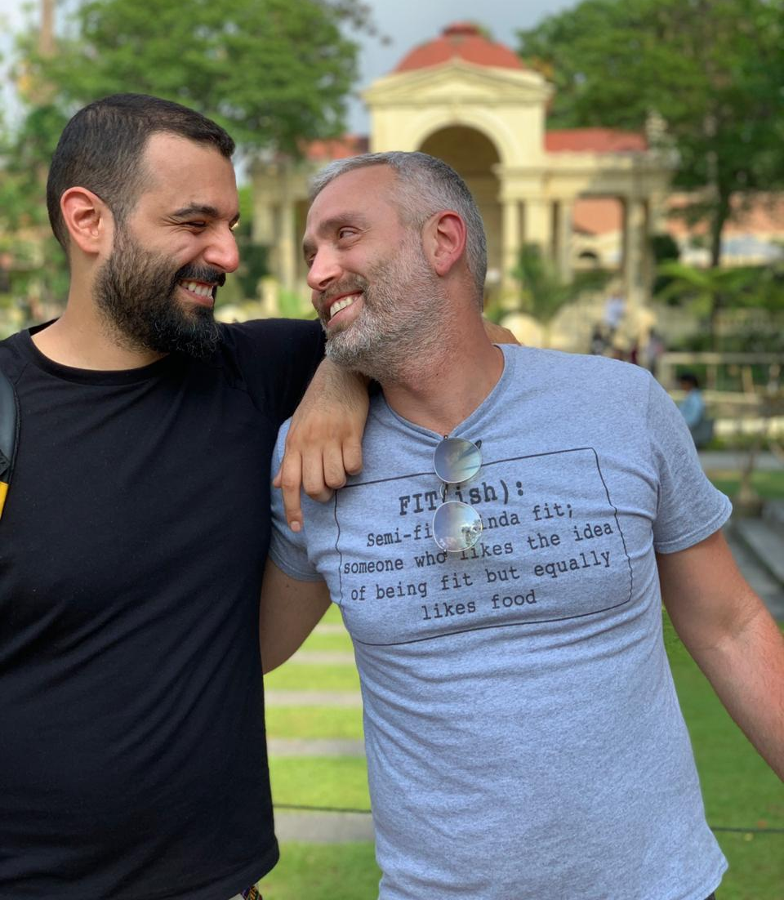
Community Reports
Ayala G, Baggaley R, Konstantinov B, Leonelli S, MacDonald V, Rafif N, Sladden T, Sundararaj M, Tartaglione G, Tome J, Verster A. Out With It: HIV and Other Sexual Health Considerations for Young Men Who Have Sex with Men. Technical brief published by MPact and supported by the World Health Organization, the United Nations Development Programme, and the United Nations Population Fund. July 2018.
Baer J, Butler J, Ayala G (Eds). Implementing Comprehensive HIV and STI Programmes with Men Who Have Sex with Men: Practical Guidance for Collaborative Interventions. 2015. United Nations Population Fund: New York.
Beck J, Peretz JJ, Ayala G. Services Under Siege: The Impact of Anti-LGBT Violence on HIV Programs. The Global Forum on MSM & HIV (MSMGF). December 2015.
Ayala G, Makofane K, Do TD, Santos GM, Beck J, Scheim AI, Hebert P, Arreola S. Rights in action: Access to HIV services among men who have sex with men. Policy Brief published by LINKAGES at FHI360 and supported by USAID/PEPFAR. December 2015.
Makofane K, Beck J, Ayala G. MSM in Sub-Saharan Africa: Health, Access, and HIV: Findings from the Global Men’s Health and Rights Study. The Global Forum on MSM & HIV (MSMGF). July 2014.
Arreola S, Makofane K, Ayala G. Values and Preferences of MSM: The Use of Antiretroviral Therapy as Prevention. Commissioned by the World Health Organization. February 2014.
Ayala G, Do TD, Semugoma P, Sundararaj M. Engaging with Men who Have Sex with Men in the Clinical Setting: A Primer for Physician, Nurses and Other Health Care Providers. The Global Forum on MSM & HIV. May 2011.
Arreola S, Ayala G, Banos O, Beck J, Keatley J, Sundararaj M. In Our Own Words: Preferences, Values and Perspectives on HIV prevention and Treatment. The Global Forum on MSM & HIV (MSMGF), commissioned by the World Health Organization. December 2010.

Slide 16
Acknowledgements
GMHR Team
Funders
George Ayala
Sonya Arreola
Angel Fabian
Milo Glenn-Santos
Nadia Rafif
Diego Solares
Mohan Sundararaj
Johnny Tohme
Doan Thanh Tung
Jeffrey Walimbwa
The SHAG Consortium
MPact International Steering Committee
The Bill and Melinda Gates Foundation
FHI360/LINKAGES
Ministry of Foreign Affairs – the Netherlands
Robert Carr Fund
USAID
WHO

Slide 17
www.mpactglobal.org

