Slide 2
CD8⁺ lymphocyte mediated suppression of HIV expression in CD4⁺ T cells
Deanna Kulpa
Emory University
@DeannaKulpa
Share your thoughts on this presentation with #IAS2019

Slide 3
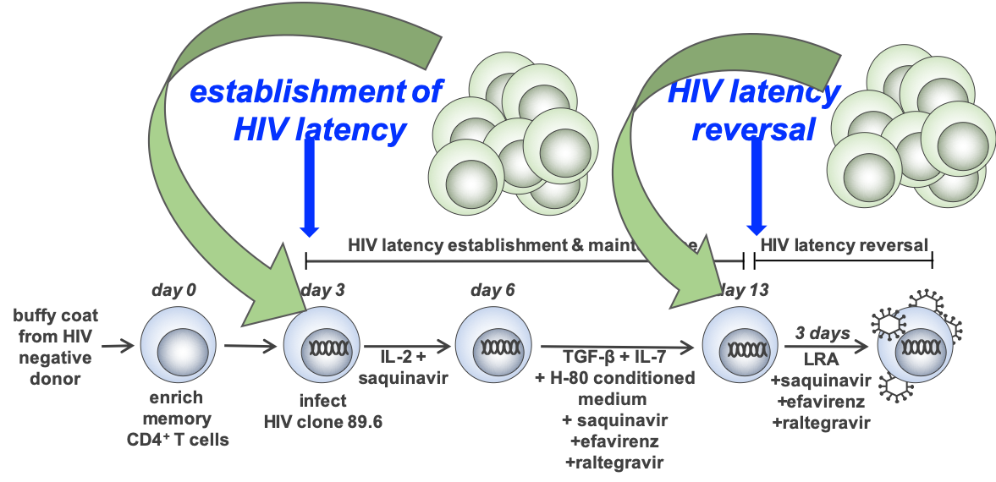
CD8⁺ lymphocyte mediated suppression of HIV expression in CD4⁺ T cells
CD8 T cell control viral replication through cytolytic and non-cytolytic mechanisms. Cytolytic mechanisms like HIV-specific CTL responses are well characterized. Non-cytolytic mechanisms include the secretion of beta-chemokines that block infection of CD4+ T cells. Numerous studies also have demonstrated that CD8+ T cells inhibit virus replication during untreated HIV/SIV infection. The mechanisms responsible for this antiviral effect remain poorly understood. Non-cytolytic mechanisms may play a role in the establishment and maintenance of the latent reservoir that remain after ART initiation. Using an in vitro model of HIV latency, we have shown that CD8 T cells can suppress HIV expression in CD4 T cells. Suppression of HIV expression is observed during in vitro latency reversal, suggesting a role for CD8 T cells in controlling viral replication beyond CTL lysis.
HIV latency
establishment
HIV latency
reversal
Franchitti et al MOPDA0105LB

Slide 4
CD8+ control of HIV replication includes cytolytic and non-cytolytic mechanisms
CD8 depletion in the NHP primate model of SIV infection using ART treated rhesus macaques has demonstrated detectable plasma viremia despite maintenance of therapeutic suppression (Guido Silvestri, Emory University).
We employ a primary cell based in vitro model of HIV latency to elucidate the mechanisms by which CD8 T cells enable the establishment and persistence of HIV latency.
We demonstrate CD8 T cells can inhibit HIV expression in resting and activated CD4+ T cells independent of CTL killing using non-HLA mediated mechanisms.

