Slide 2
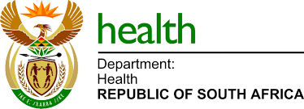
Improving uptake for Voluntary Male Medical Circumcision in traditional initiation settings
Kevin Bellis, Clinton Health Access Initiative, South Africa
Collen Bonnecwe, National Department of Health, South Africa

Slide 3
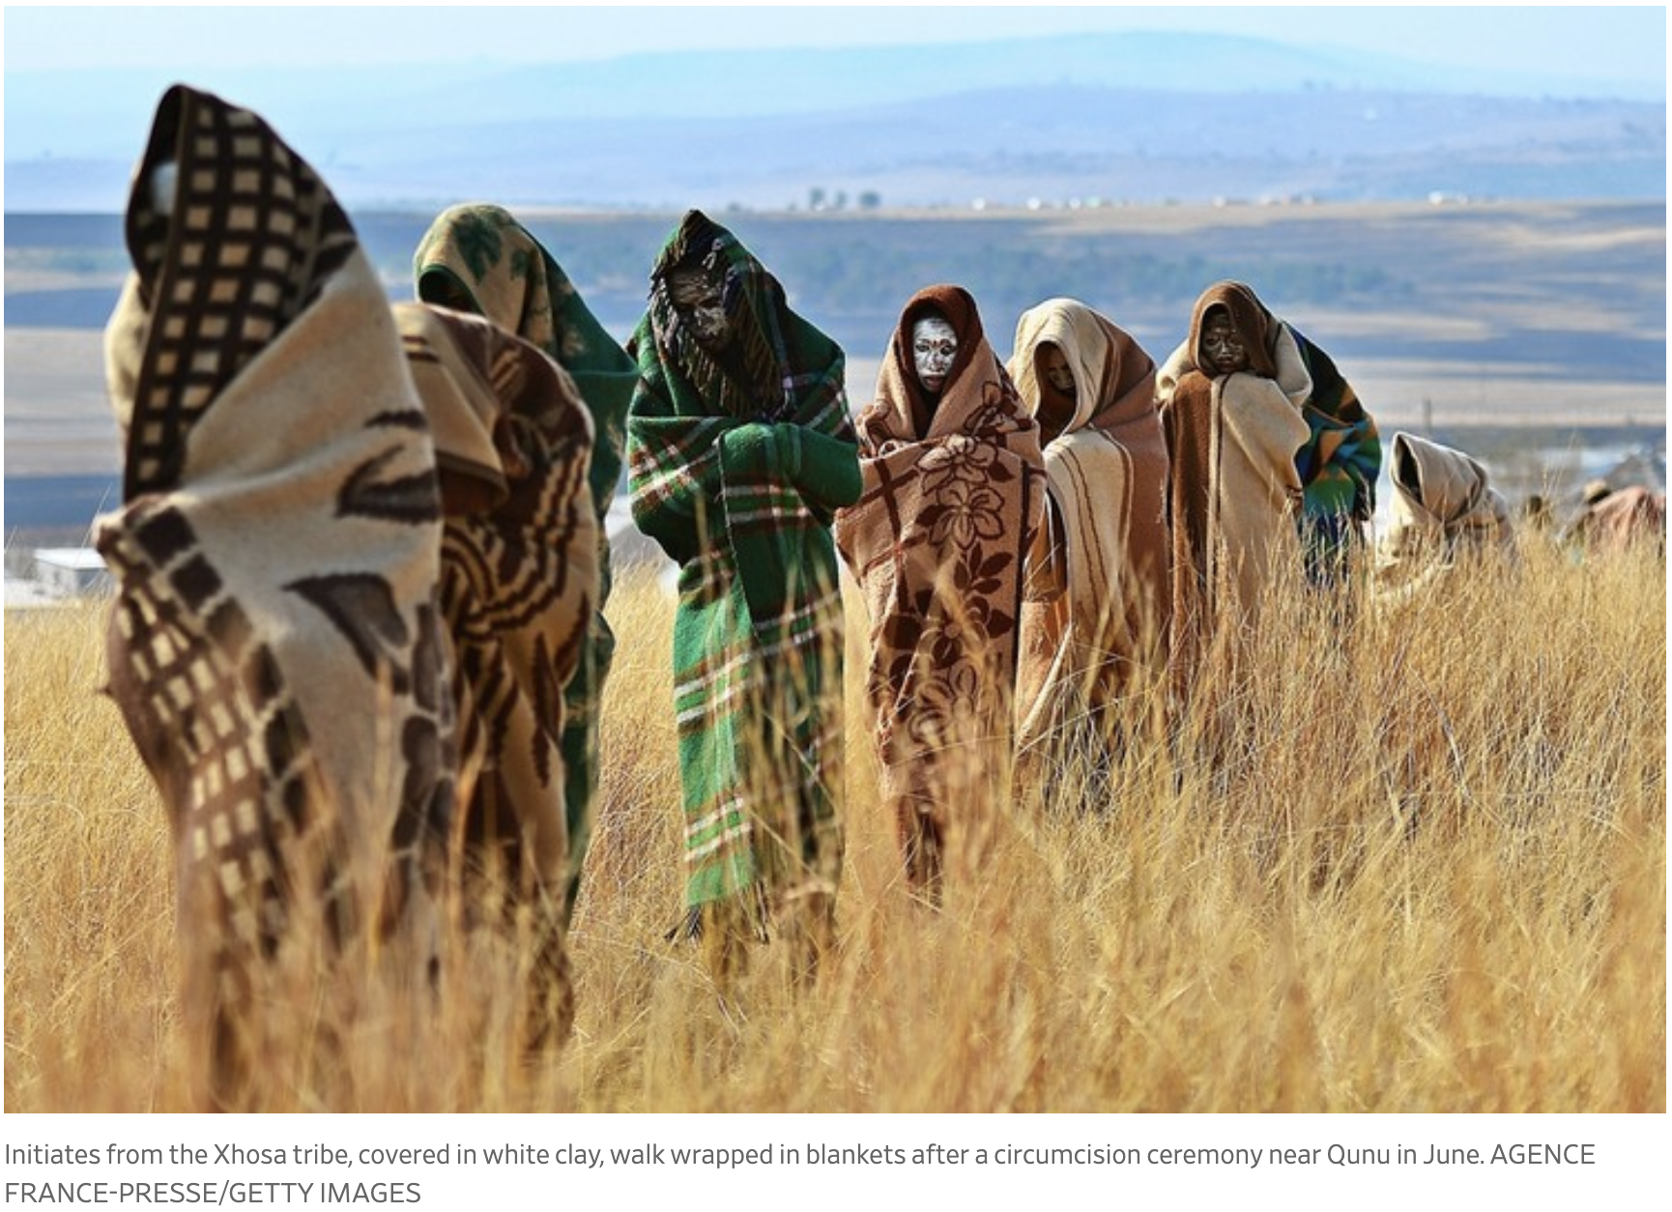
Traditional Initiation in South Africa
Male rites of passage are not standardized across South Africa
Mixed cultural and religious practices vary by Province
Secrecy in cultural practices are only now becoming more open as post-apartheid legacy and gender norms are challenged
Increasing community pressure to reduce death and disfigurement rates
Notes:
Male rites of passage – African cultural practices vary
Three major provinces, some localised circumcision in three other provinces
Jewish and Muslim communities
Notoriously hard area to break into – cultural norms established but sometimes divergent – eg Biko and Mandela
Secrecy is important factor in the ritual – not allowed to be discussed by non initiates
Death and disfgurement

Slide 4
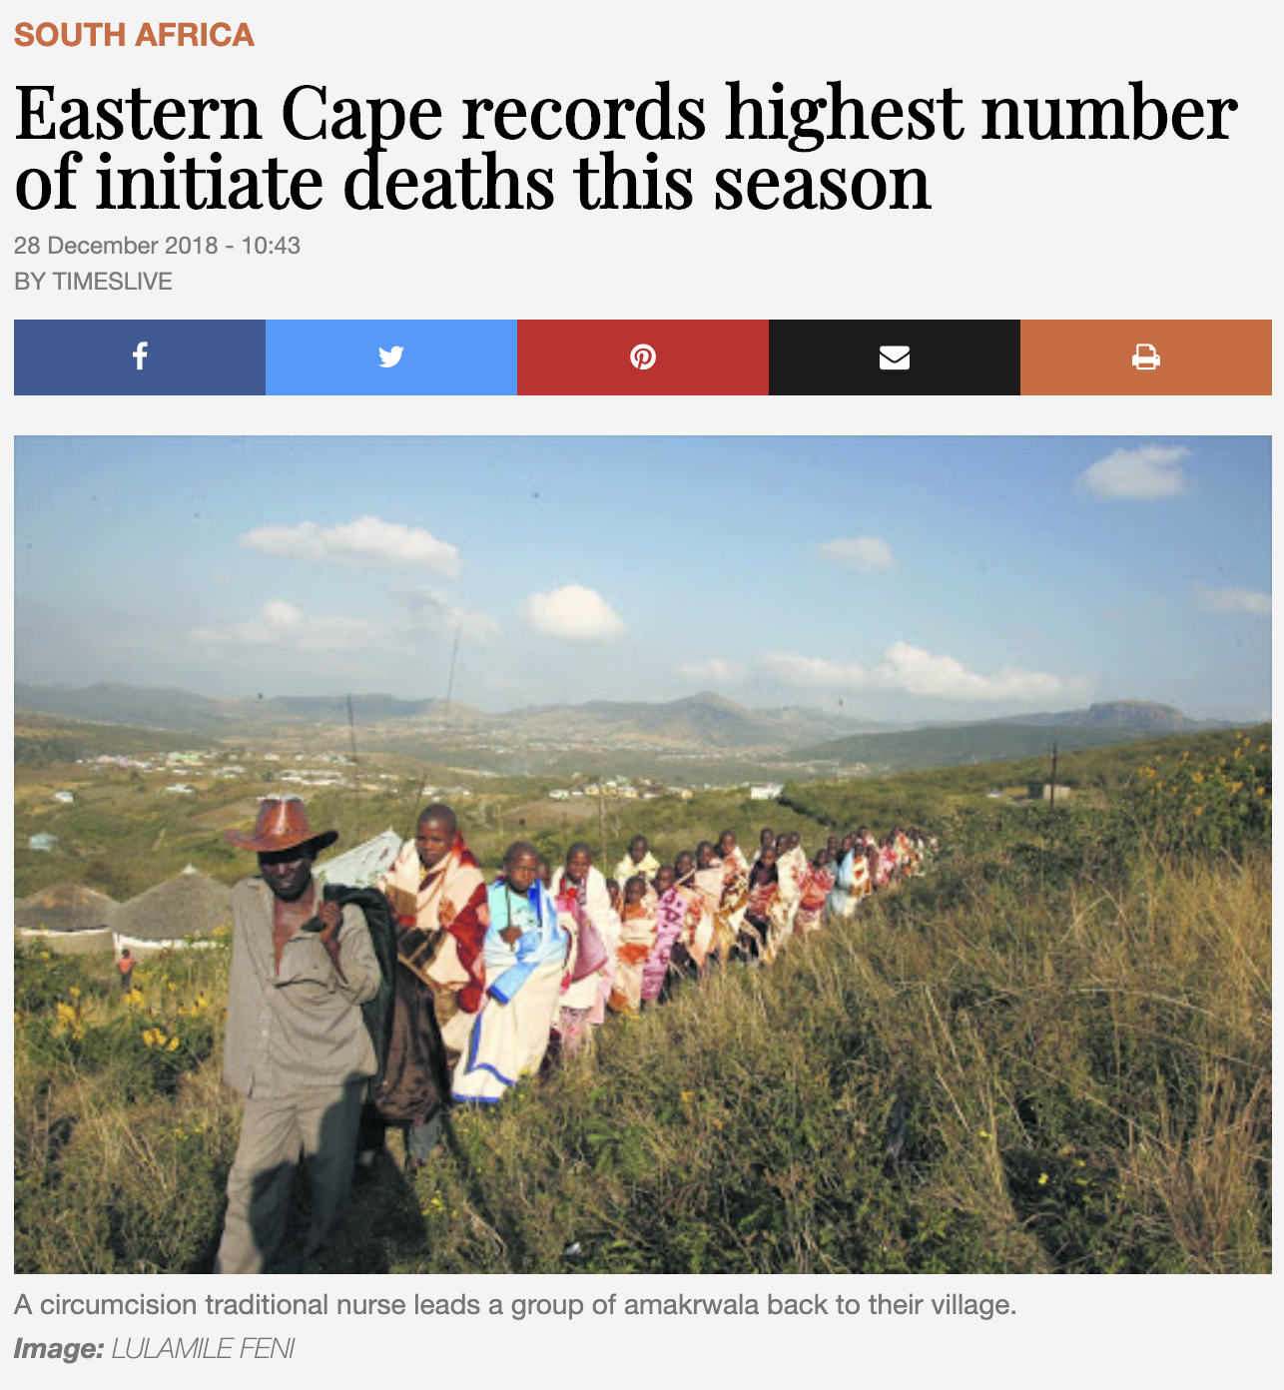
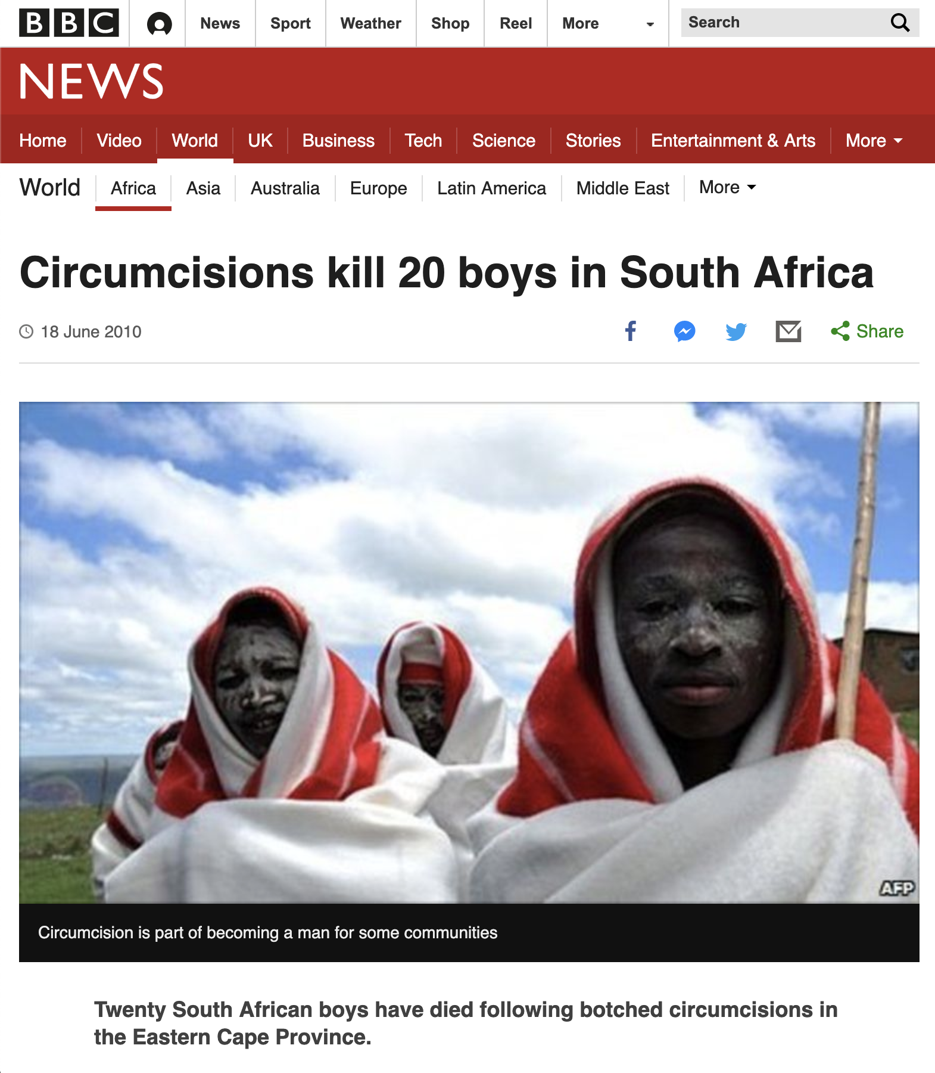
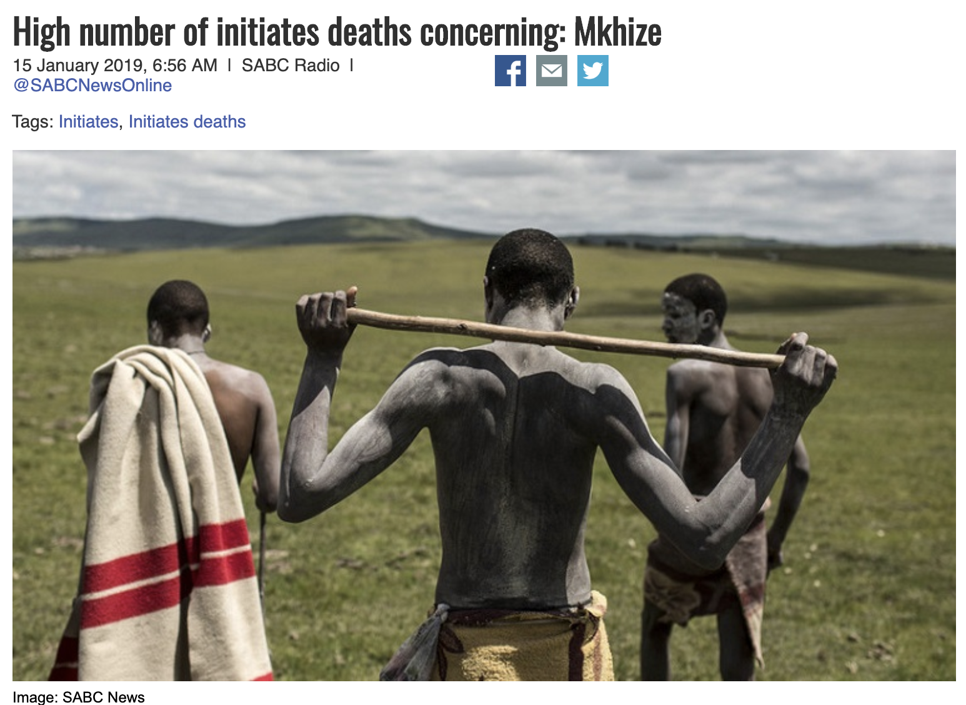
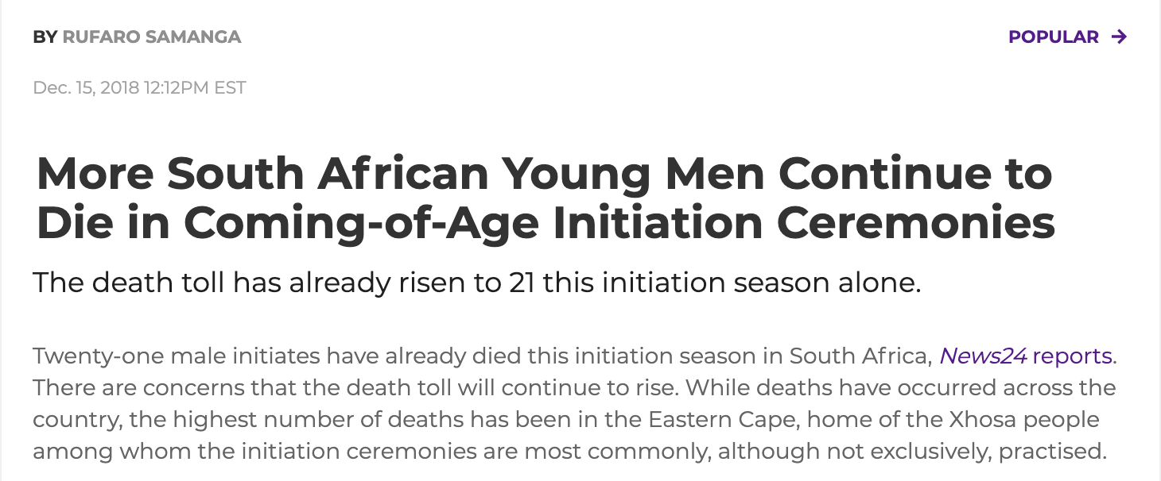
Medical risks are well known
Notes:
Medical Risks are well known
Long term there have been legal and cultural attempts through Depts of Health and CoGTA to minimise deaths

Slide 5
Rationale for introduction of VMMC into traditional initiations
Large scale cultural practice in SA male population
Medical Circumcision (involving full removal of foreskin) can reduce HIV infections
Reduce rates of death and disfigurement through traditional circumcision
Synchronicity with initiation cycle in winter 2017 (April to September)
Meet changing needs
Notes:
This is a large scale cultural practice in SA – recognised opportunity to engage a large group of males that was assumed to either traditional circumcise OR medically circumcise
Recognition that circumcision reduces potential for HIV infection
Produces a higher quality outcome – reduces death & disfigurement
EC 2001 – 2006 Initiates 2262 Hospital admissions 115 deaths and 208 genital amputations

Slide 6
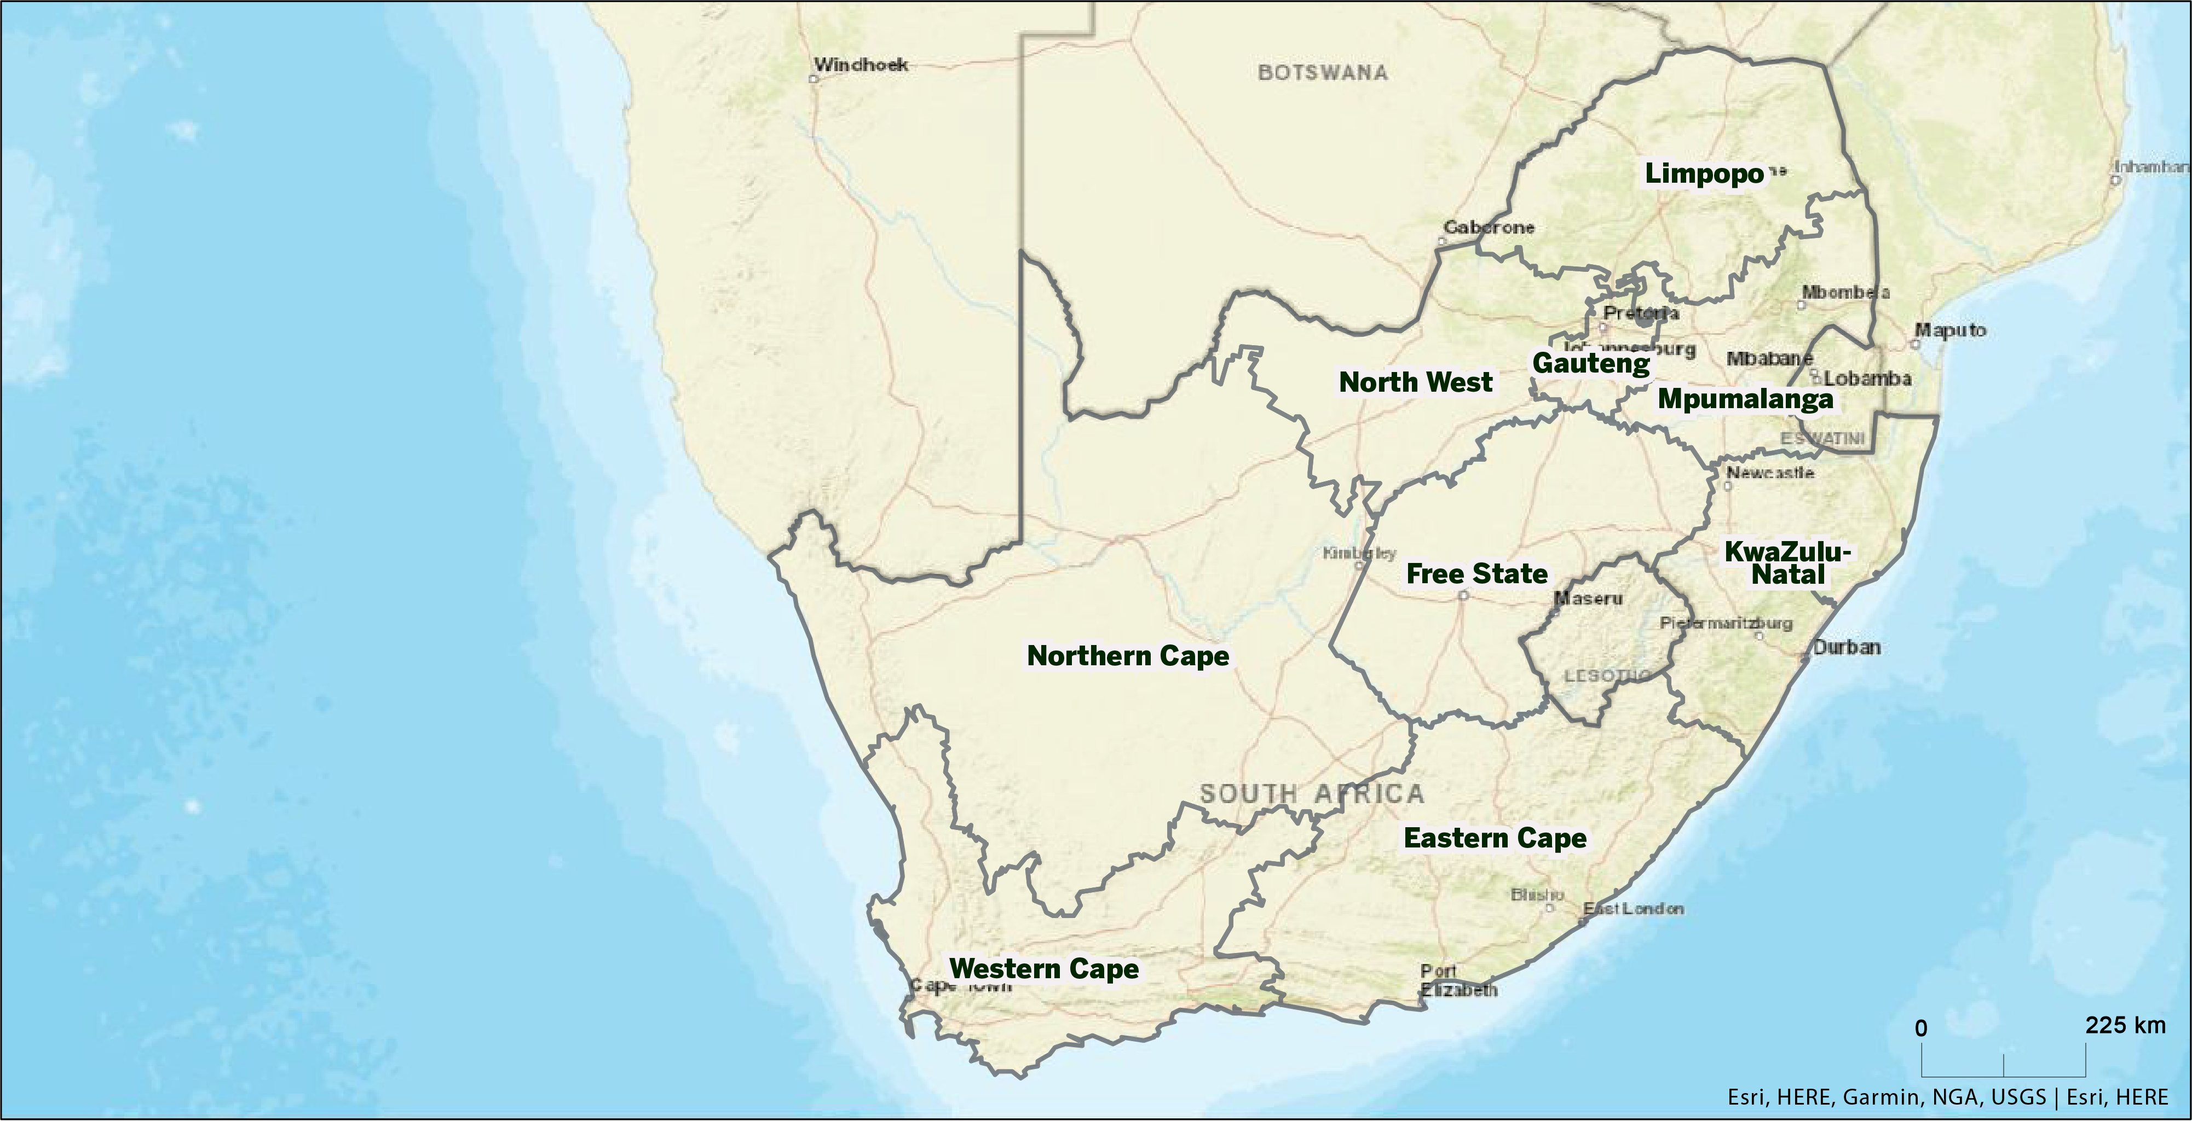
South Africa General Overview
Mixed cultural and religious practices vary by Province

Slide 7
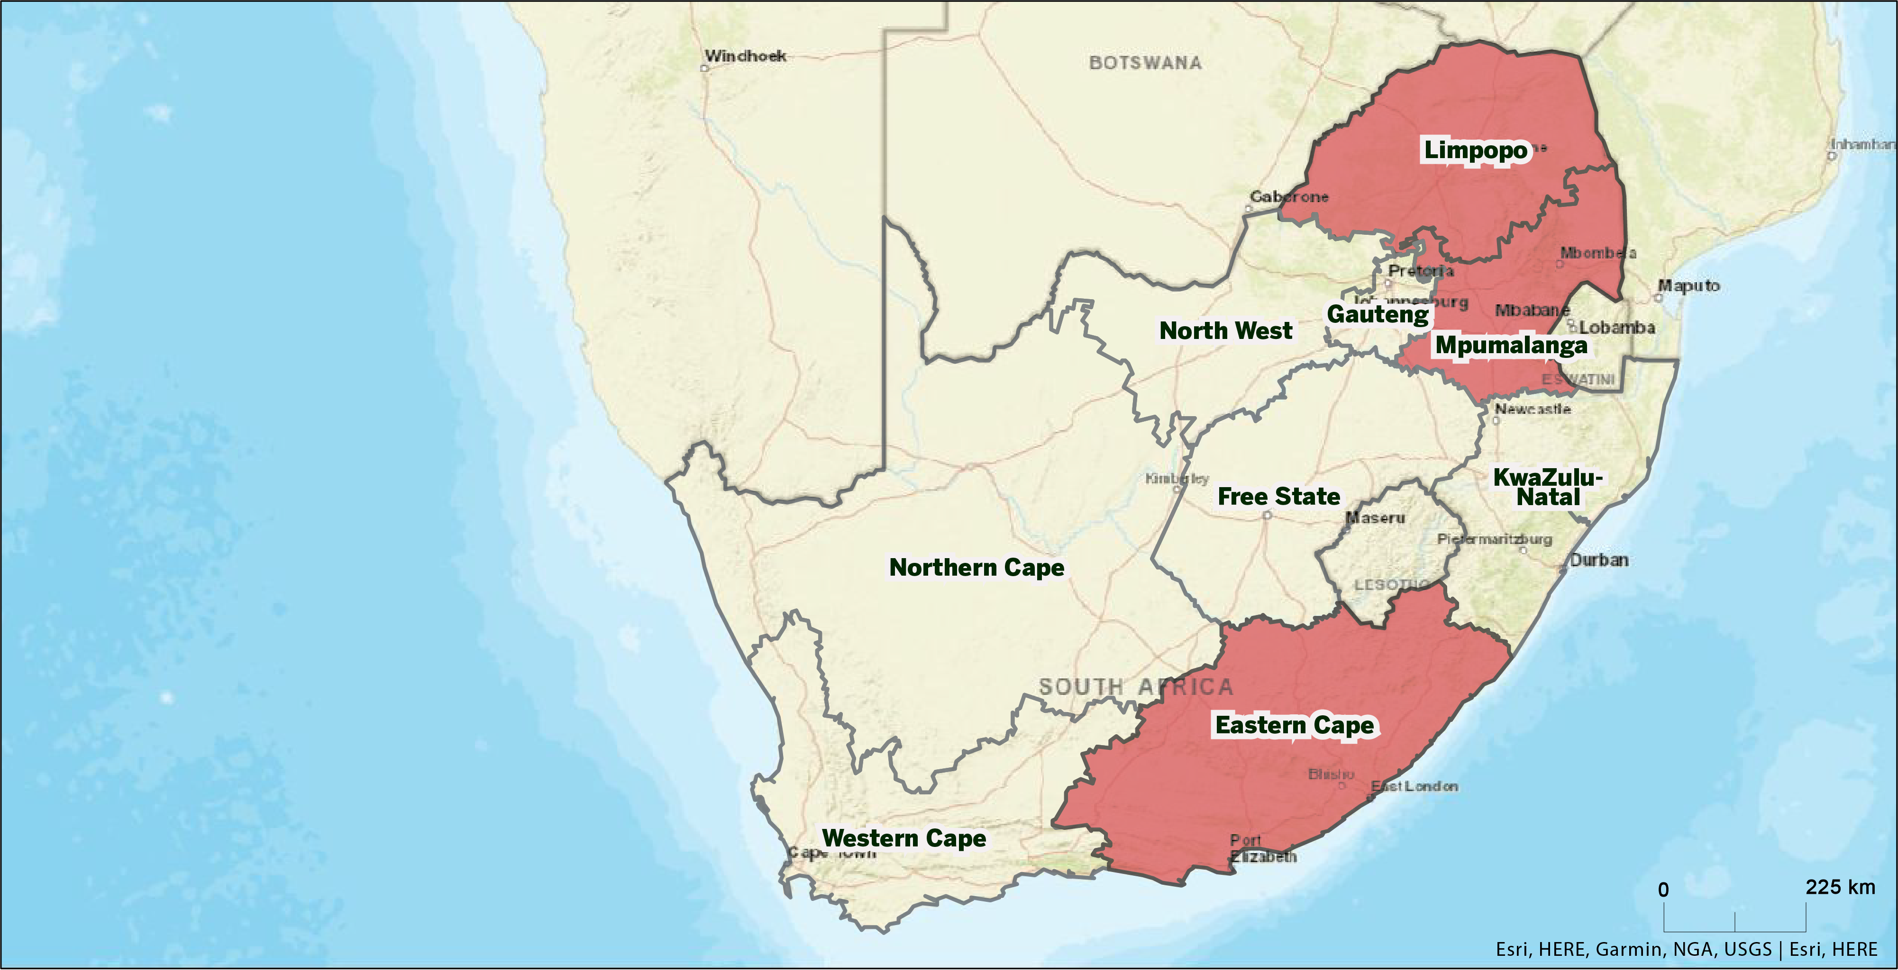
Based on initial research Intervention potentially targeted in three Provinces
Eastern Cape – largest number of traditional circumcision schools
Limpopo – traditional circumcisions but with different cultural groups in one province
Mpumalanga – traditional circumcision in a single cultural group

Slide 8
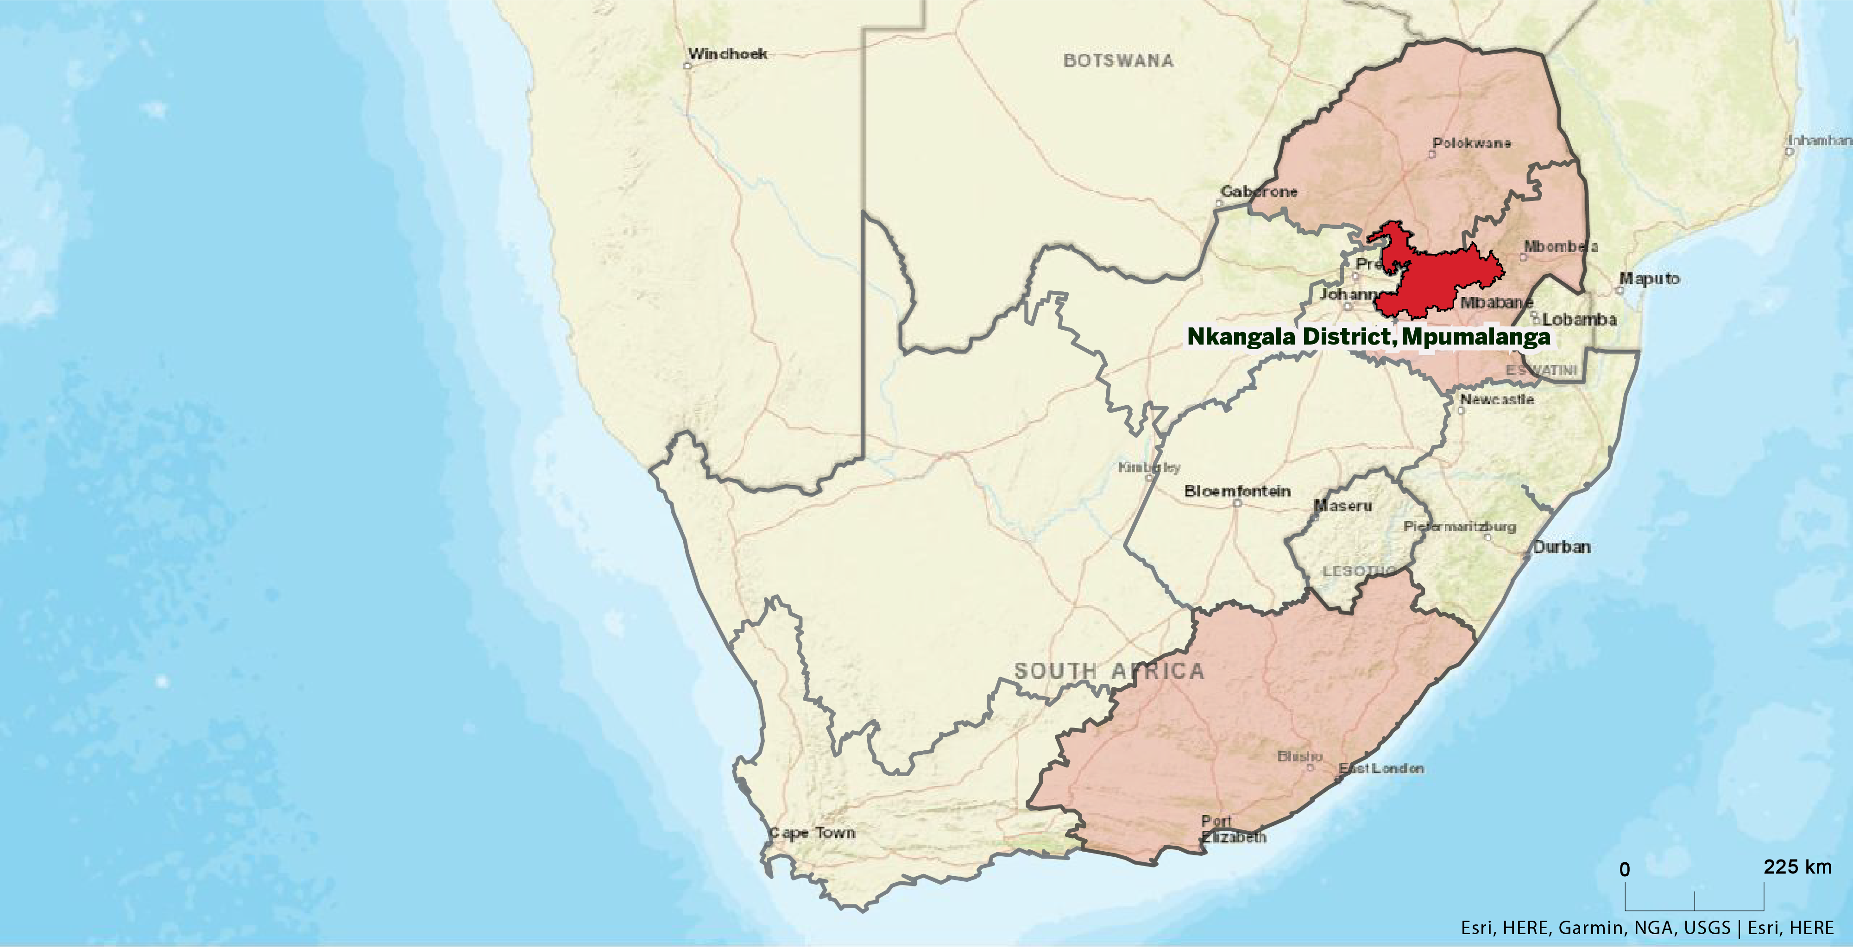
Presenting data for Nkangala District, Mpumalanga
Ndebele Communities run on four year initiation school cycles in this district
Males initiated away from communities & health facilities
Initiation process may last several months
These are ‘closed’ initiation communities

Slide 9
Key Factors for addressing traditional initiation integration
Discussions/Negotiations with traditional leaders focused on benefits of HIV prevention in their communities
Discussions/Negotiations with leaders of traditional initiation schools
Recognition of the Ingoma Forum in Mpumalanga Province
Recruitment of male staff (who had be initiated themselves) to undertake care from service providers
Outreach from Ingoma Forum & CHAI to support initiation camp leaders
Integration with PEPFAR Service providers
Data collection focus
Data collection nodes at sub-district level
Provision of surgical kits to PEPFAR / Ingoma Forum staff to undertake MMC
Surgical reviews undertaken

Slide 10
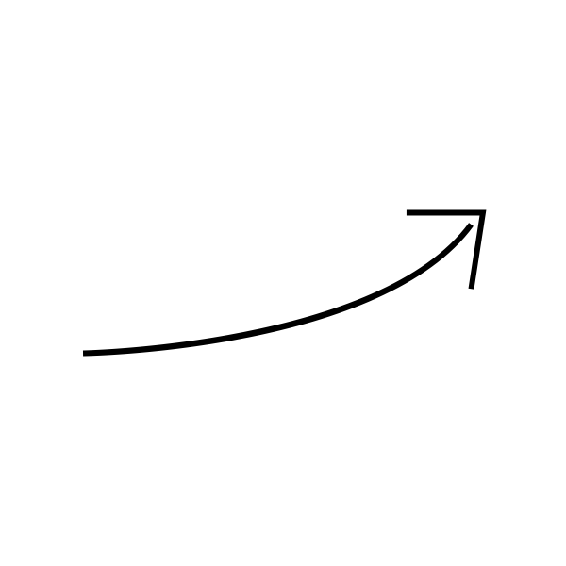
Expectations for VMMC Nkangala District
Actual
Targets
First year expectations were higher because of threatened PEPFAR retraction
30,852
Program Cessation
December 2018
Years 2 and 3 had tempered expectations
28,649
28,339
Program Initiation
January 2016
After program cessation, we expected a significant decrease
15,120
6,276
5,270
April 2014 –
March 2015
April 2015 –
March 2016
April 2016 –
March 2017
April 2017 –
March 2018
April 2018 –
March 2019
April 2019 –
March 2020

Slide 11
Results for VMCC Nkangala
Actual
45,713
Targets
45,563
Second and third year actual results vastly exceeded expectations
30,852
The effects of the programme are still continuing after programme cessation
First year actual results were significantly lower than target
28,649
28,339
23,346
15,120
6,276
5,270
6,188
April 2014 –
March 2015
April 2015 –
March 2016
April 2016 –
March 2017
April 2017 –
March 2018
April 2018 –
March 2019
April 2019 –
March 2020

Slide 12
Continued impact likely a result of community involvement
Planning
Lead time of 6 to 12 months
Community and cultural acceptance
Negotiations and understanding cultural acceptance, clarity, and delineation of purpose
Benefits of dual reporting – PEPFAR / DHIS systems
System alignment and feedback
Minimized bureaucracy and responsiveness

Slide 13
Acknowledgements
KwaNdebele cultural leaders, initiation school leaders and initiates
Mr Ayanda Nquketo
Ingoma Forum
Right to Care NGO
NDOH & CHAI VMMC Support Teams
Bill & Melinda Gates Foundation

