Slide 2
ART Rapid Start: When, Why, and for Whom?
Serena Koenig, MD, MPH
Brigham and Women’s Hospital
Harvard Medical School
Boston, MA USA
Les Centres GHESKIO
Port-au-Prince, Haiti

Slide 3
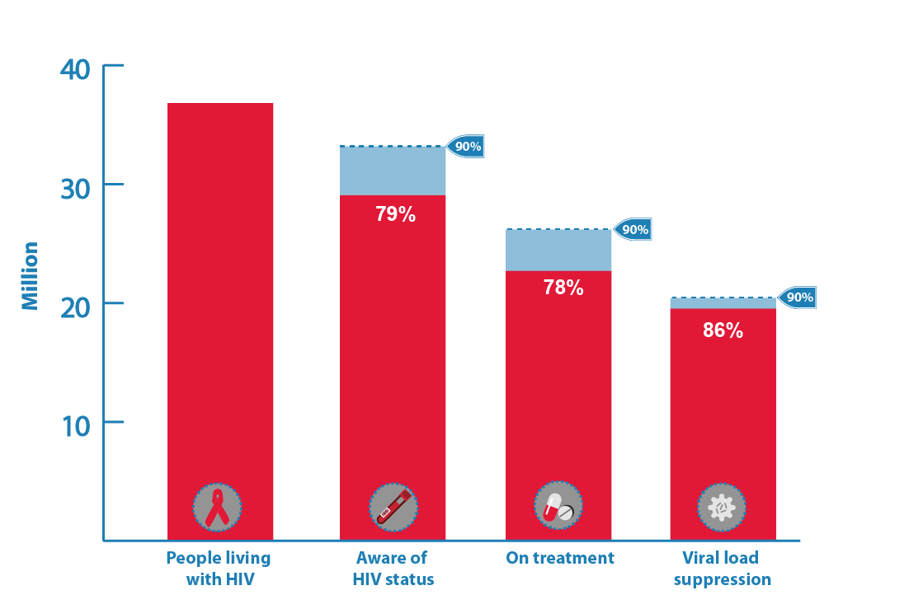
Why Is Rapid ART Important?
Source: UNAIDS/WHO estimates

Slide 4
How Can We Improve the Patient Experience Early in Care?
“How can we roll out the red carpet for our patients on the day they receive their HIV diagnosis, so they leave our clinic with hope and optimism that HIV is a treatable condition?”
-Jean W Pape, Director of GHESKIO, Haiti

Slide 5
Same-Day ART Approach
Goal: “How Simple Can We Make it to Start ART”*
COMPRESS
ACCELERATE
UPTAKE
OUTCOMES
BURDEN
Same-day HIV testing
Physical exam, lab tests, chest x-ray
ART readiness assessment
ART readiness counseling
Dispense ART
Adapted from a slide from Sydney Rosen and Lawrence Long
Niklaus Labhardt, pre-CROI meeting on SDART, 2018
Notes:
Use rapid laboratory tests at point of care for immediate determination of treatment eligibility and regimen choice
Should increase uptake of ART, improve health outcomes, and lessen burden on patients and clinics

Slide 6
WHO Guidelines July 2017
“Rapid ART initiation should be offered to all people living with HIV following a confirmed HIV diagnosis and clinical assessment.”
“Rapid” defined as within 7 days
“ART initiation should be offered on the same day to people who are ready to start.”
Goal: To improve linkage to care and reduce LTFU

Slide 7
Four RCTs that Impacted the WHO Guidelines for Rapid ART
“High-to-moderate quality evidence of benefit to all clinical outcomes assessed.”
Ford N et al, AIDS, 2017

Slide 8
CASCADE: SDART vs. SOC in Home-Based Testing in Lesotho
12-Month Viral Suppression: 50% vs. 34%
12 months engagement in care
Labhardt ND et al. JAMA 2018, Mar 6;319(11):1103-12.
IAS 2019: Abstract Nb MOPEB 217;
Abstract No: MOPED635
$

Slide 9
RapIT: RCT of Single-visit ART vs. SOC in South Africa
Outcome | Standard n=190 |  | Rapid n=187 |  | Crude risk difference | Crude relative risk
Initiated ≤ 90 days | 136 (72%) |  | 182 (97%) |  | 25% (19-33%) | 1.36 (1.24-1.49)
Initiated ≤ 90 days and retained and suppressed by 10 months | 96 (51%) |  | 119 (64%) |  | 13% (3-23%) | 1.26 (1.05-1.50)
Of those not initiated ≤ 90 days and suppressed by 10 months:
Not initiated |  | 54 (28%) |  | 5 (3%)
Initiated but not suppressed or with no viral load reported |  | 40 (21%) |  | 63 (34%)
Initiated ≤ 90 days and retained at 10 months |  | 121 (64%) |  | 151 (81%) | 17% (5-23%) | 1.27 (1.12-1.44)
Of those not initiated ≤ 90 days and retained at 10 months:
Not initiated |  | 54 (28%) |  | 5 (3%)
Initiated but not retained |  | 15 (8%) |  | 31 (17%)

Slide 10
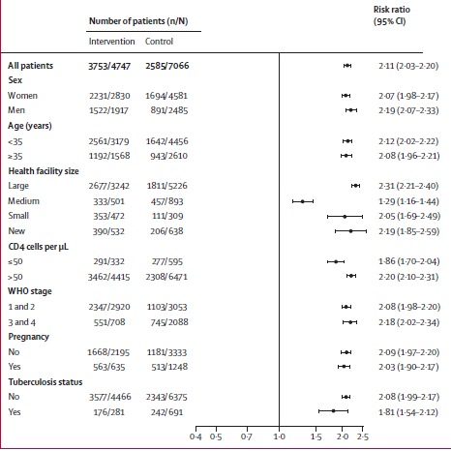
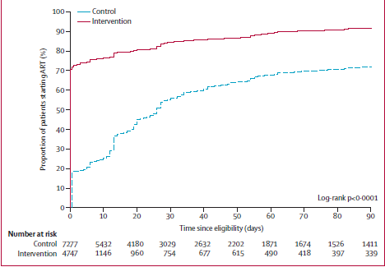
START-ART Package of Care vs. SOC in Uganda
80% ART start by 2 weeks
38% ART start by 2 weeks
Virologic suppression at 1 year was superior in intervention group (85% vs. 75%); if missing data were treated as failures, 66% vs. 58% achieved viral suppression
Amanyire, Lancet HIV, 2016
Slide Courtesy of Diane Havlir and START-ART Team
Amanyire et al, Lancet HIV, 2016
Notes:
pre

Slide 11
SDART Haiti: RCT of Same-Day ART vs. Day 21 ART
Kaplan-Meier Curve of 12-month retention in care
12-month retention in care: 72% standard vs. 80% in SDART group
Koenig et al, PLOS Med, 2017
Notes:
We attempted to give the same level of high-quality care to both groups (including transportation vouchers, phone calls for missed visits). In the SOC group, counseling was provided prior to ART initiation. In the SDART group, counseling was provided on Day 0, and in the early period after ART initiation.

Slide 12
Same-Day ART Study in Haiti
Koenig et al, PLOS Med, 2017
Notes:
We attribute the higher rate of mortality in the SOC group to patients with low CD4 counts who were LTFU prior to ART initiation.

Slide 13
What about Early LTFU after Rapid ART Initiation?
Low barrier to starting ART, so many patients are included who would otherwise have been LTFU prior to ART initiation
“One point of SDART is to nudge patients who are on the fence, rather than sending them away empty-handed and letting them fall off onto the wrong side of the fence.”*
LTFU will be shifted from pre-ART to post-ART without additional efforts to keep these “semi-committed” patients in care
*Lawrence Long and Sydney Rosen
Notes:
These are the patients who would not have overcome the barriers to starting ART in the old system.

Slide 14
What about Patients with TB Symptoms at HIV Diagnosis?
TB testing necessary
Xpert Ultra higher sensitivity than Xpert in PLWH (90% vs. 77%)
But logistical challenges in providing same-day results if specimens tested in central lab
Xpert results can be provided at second visit → Will patients return for result if it is provided in an efficient manner?
Traffic between clinic and TB lab in Port-au-Prince
Dorman S et al. Lancet ID 2018
Notes:
We are currently conducting an RCT of same-day treatment for patients with TB symptoms at HIV diagnosis. We are doing same-day Xpert, but it’s challenging….

Slide 15
SLATE-1 Study – Clinical Algorithm for SDART Eligibility
RCT in South Africa and Kenya - adults presenting for HIV care, including HIV testing
Symptom report, medical history, exam, readiness assessment for SDART eligibility
 | South Africa (n=298) | Kenya (n=240)
Proportion NOT Eligible for SDART according to algorithm | 149/298 = 50% | 109 (45%)
Reasons for ineligibility
Tuberculosis symptom | 109 (73%) | 93 (85%)
Persistent headache | 17 (11%) | 31 (28%)
Previously defaulted ART | 14 (9%) | 18 (17%)
Not ready | 6 (4%) | 3 (3%)
Substance abuse issues | 6 (4%) | 12 (11%)
Concerning clinical condition | 6 (4%) | 7 (6%)
96% of patients indicated they would want to start ART on the day if they could
Rosen S et al, in press

Slide 16
SLATE II – RCT in South Africa
Similar to SLATE I, but nurses distinguished mild vs. severe TB symptoms
Mild symptoms – Sputum for Xpert, start ART
Severe symptoms – Delay ART for TB investigation
75% of intervention group reported TB symptom; 13% delay for investigation
 | Standard Group (n=297) | Intervention Group (n=296)
Initiated Same-Day ART | 105 (35%) | 257 (87%)
Initiated ART by Day 28 | 189 (64%) | 271 (92%)
After ART initiated, TB confirmed by positive Xpert MTB/RIF | 9 (3%) | 6 (2%)
Serious adverse events reported | None | None
98.5% said they would like to start same-day ART if possible
Rosen S et al unpublished data
Notes:
Further studies are underway about the optimal strategies to rule out TB prior to ART initiation. Faster, easier, cheaper, truly POC TB diagnostics could have a big impact here.

Slide 17
What about High-Income Countries?
Cohort Studies of Rapid ART Initiation
San Francisco General Hospital, RAPID Model
→Faster time to suppression/higher rate of suppression
REACH, Atlanta
→ Faster time to viral suppression
Crescent Care Start, New Orleans
→ Faster time to suppression/higher rate of suppression
Pilcher CD et al, JAIDS 2017; Hughes A et al, IAS 2018; Coffey AIDS el al 2019; Colasanti J et al OFID 2018; Halperin J et al, OFID 2019

Slide 18
IAS-USA Guidelines, 2018
”ART should be initiated as soon as possible after diagnosis … unless patient is not ready.”
“Structural barriers that delay receipt of ART should be removed to allow newly diagnosed patients to receive ART at the first clinic visit….”
Treatment may be started before test results are available (HIV-1 RNA, CD4 count, resistance testing, chemistries, hepatitis serologies)
Recommended ART for Rapid Start:
Biktarvy (bictegravir/TAF/FTC)
Dolutegravir or boosted darunavir with TAF/TDF + FTC/3TC
Saag MS et al. JAMA 2018

Slide 19
Conclusions
In LMIC, rapid ART has been shown to be safe and effective in adult patients, even for patients with TB symptoms
Further interventions will be necessary to improve retention in care after rapid ART initiation
Further study is necessary to determine optimal strategies for adolescents, children, and pregnant women
Further questions remain about optimal management of patients who present with serious symptoms

Slide 20
Acknowledgements
Special thanks for advice regarding this presentation:
Jean William Pape
Sydney Rosen
Sean Collins
Niklaus Labhardt
Jonathan Colasanti

