Slide 1
Consumption of recreational drugs and their sexualized use in gay men, bisexual and other MSM from Latin America:
Preliminary results of the Latin American MSM Internet Survey (LAMIS)
Presenter: E. Michael Reyes Diaz MD, Ms(c)
Center for Research in Sexuality, AIDS and Society, Universidad Peruana Cayetano Heredia, Lima, Peru
Prepared by: Percy Fernández-Dávila, PhD
Stop Sida Research Department, Barcelona (Spain)

Slide 2


No conflicts of interest to declare

Slide 3
Introduction
Sexualised drug use (SDU) among gay, bisexual and other men who have sex with men (GBMSM) is causing concern in many high-income countries, because of the multiple risks for their psycho-social/sexual health.
Sesión/colocón (Spain), ChemSex (UK) or Party and Play (USA) are commonly used terms related to SDU which is defined as the intentional use of drugs, to sustain sex for a longer period of time (from several hours to days) and increase pleasure. The more time, greater exposure to various health risks or harms.
In Latin America there is no published study that allows us to estimate the magnitude of SDU among GBMSM.

Slide 4
Objetives:
Describe the pattern of recreational drug use and SDU
Characterize users among Latin American GBMSM.

Slide 5
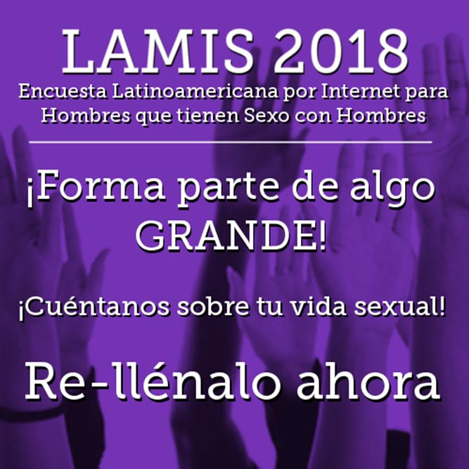
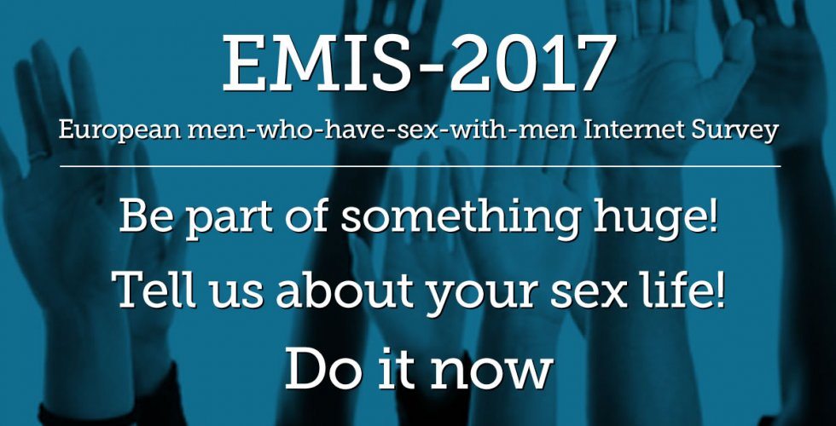
Method
The Latin America MSM Internet Survey 2018 (LAMIS2018) is the Latin American adapted version of the European MSM Internet Survey 2017 (EMIS2017).
It was conducted to obtain comparable infomation about MSM across Latin American countries.
https://www.esticom.eu/Webs/ESTICOM/EN/emis-2017/emis-2017-node.html
https://www.red-iberoamericana.net/lamis

Slide 6
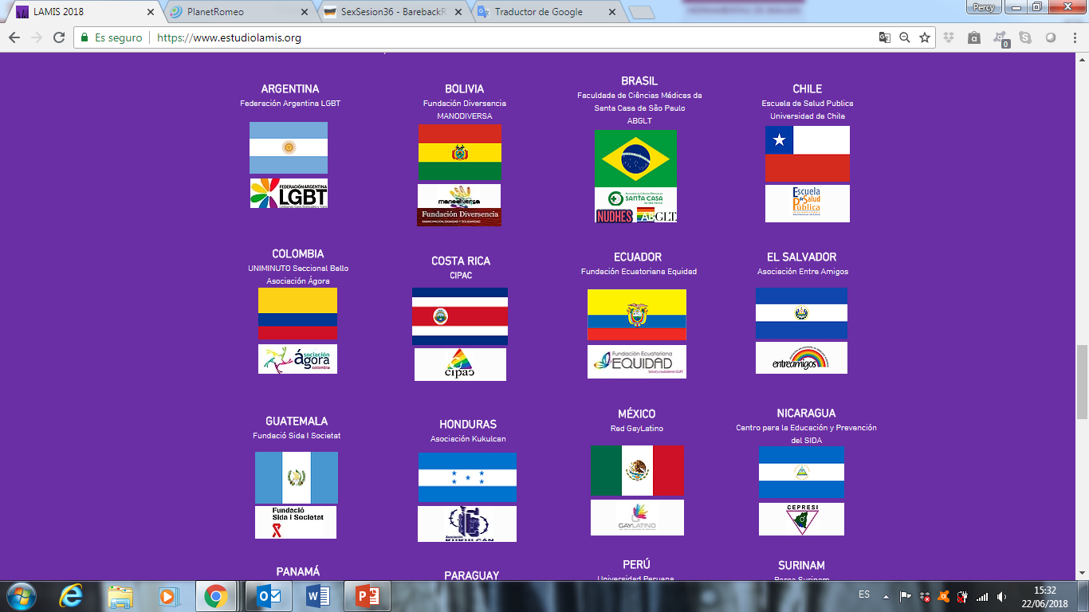
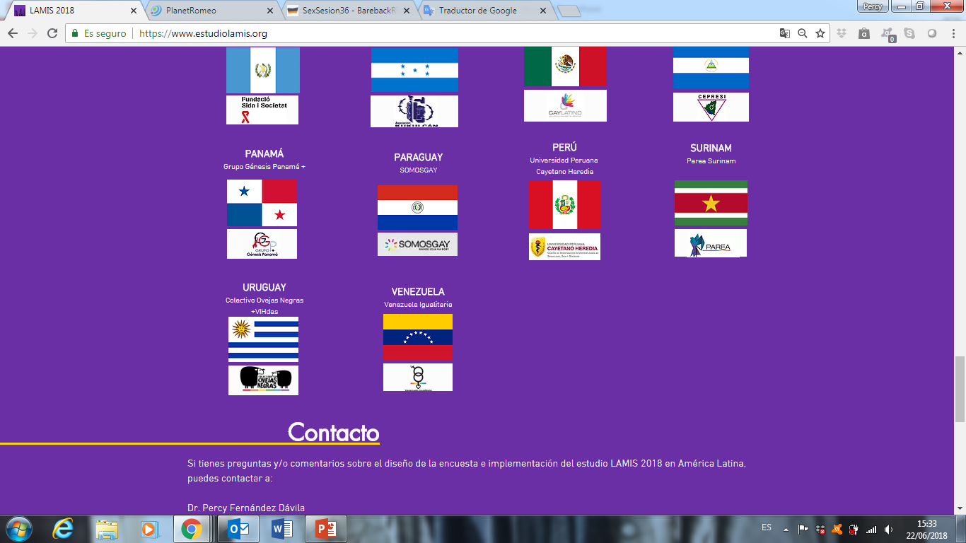
An online questionnaire was available in 3 languages (Spanish, Portuguese and Dutch), from January to May 2018 (110 days) in 18 countries.

Slide 7
Information from the questionnaire: sexual behaviours, drug use, psycho-social health (mental health, internalized homonegativity, homophobia, social support), HIV/STI knowledge, HIV/STI testing, HIV/STI diagnosis
Inclusion criteria:
  Age: 18 years old or older
  Man or transgender man attracted to or engaged in sex with other men
  Live in one of the participating countries.
Recruitment was carried out using central (international websites and gay-dating apps) and local promotion (LGTB+/HIV NGOs, social networks, press releases, WhatsApp, offline, etc).

Slide 8
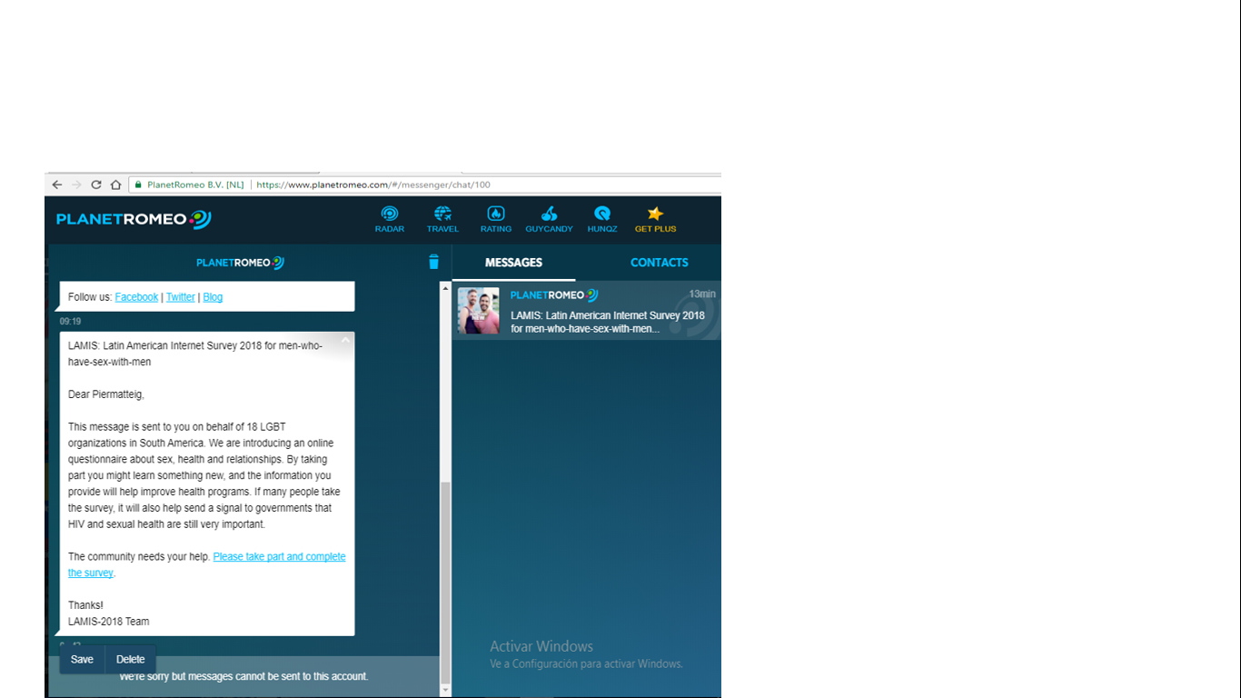
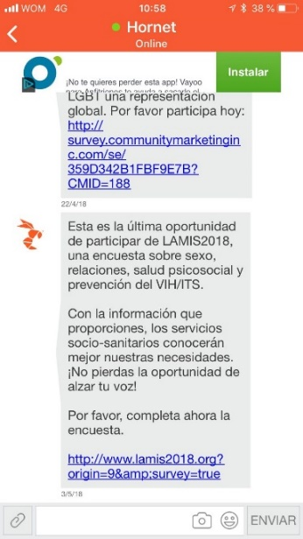
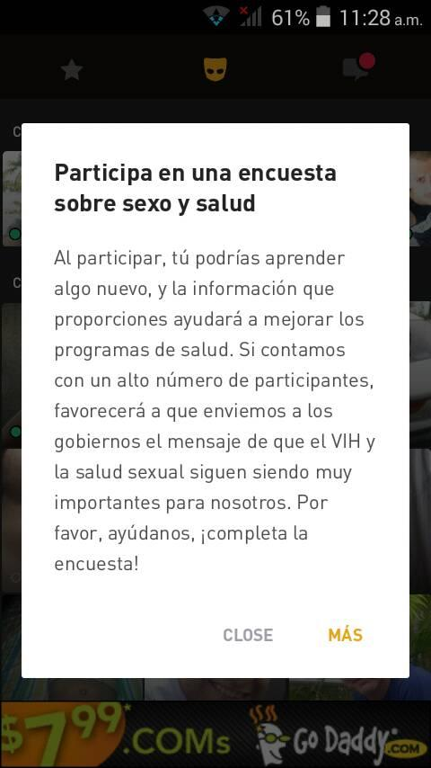
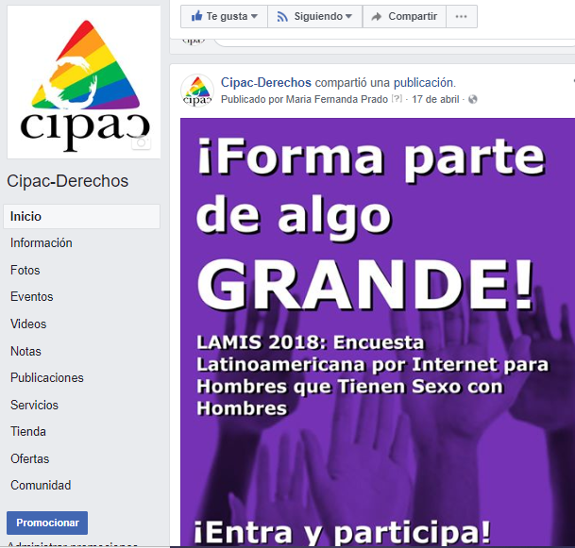
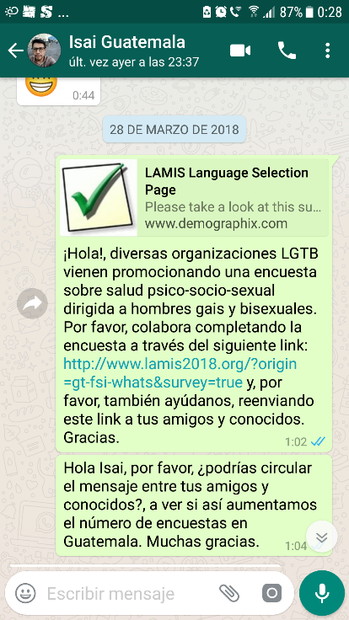
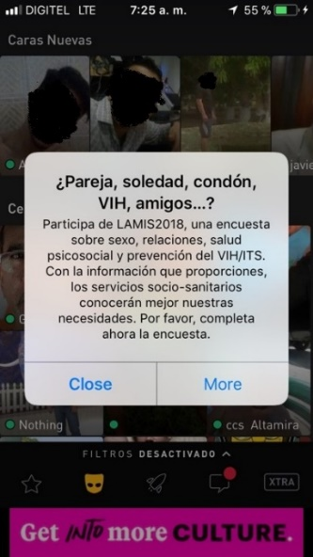
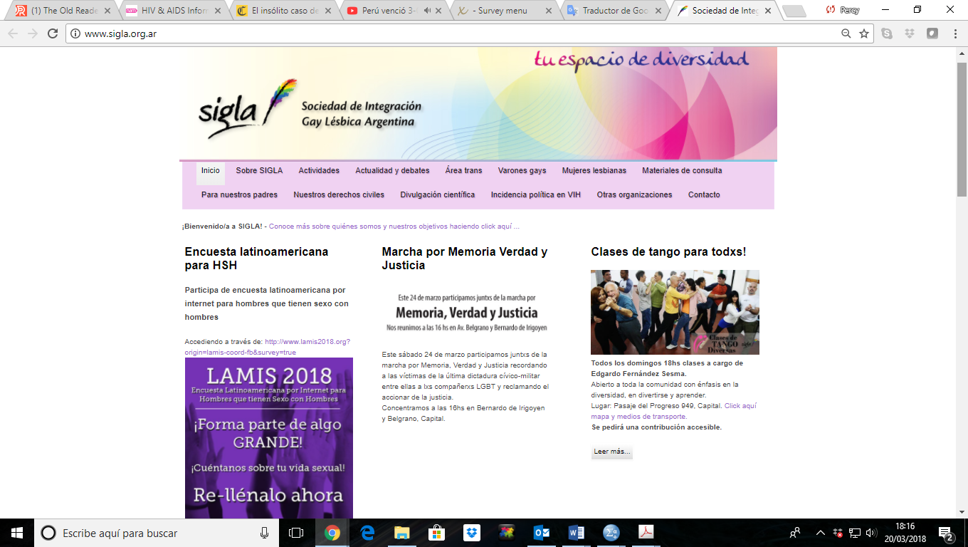
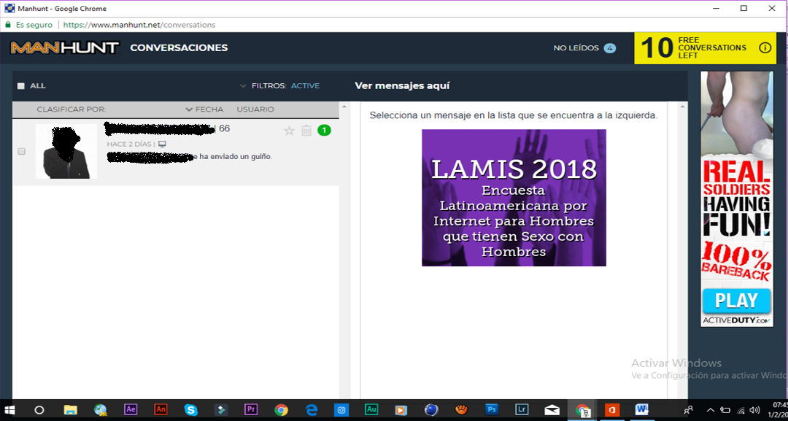
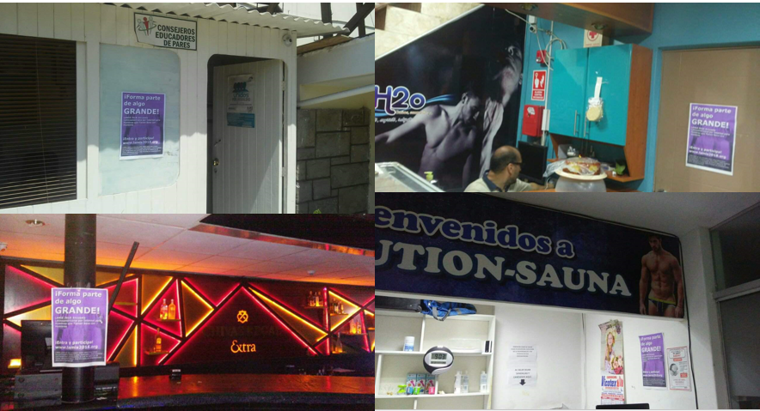
Central promotion: international gay websites and apps (PlanetRomeo, Grindr, Hornet, ManHunt)
Local promotion:
NGOs (websites, mailing), digital magazines, social networks, press releases, WhatsApp, offline

Slide 9


Results

Slide 10
Number of participants by country (n=64,655)
51%
80%
  Mean age was 29.8 years old with a range from 18 to 81 years old.

Slide 11
When was the last time you used drugs to make sex more intense or last longer? (n= 63,939¹)
p<0.001
¹ 716 missing cases
Souther cone: Argentine, Chile, Paraguay, Uruguay
Andean region: Bolivia, Colombia, Ecuador, Peru, Veneuela

Slide 12
Drug use by context (general vs. last non-steady sex) (n=64.655)
Before/during last sexual session with non-steady partner

Slide 13
Drug use (general vs. last sex) among those men who used drugs to make sex more intense or last longer in the last 4 weeks (n=4,264)
Used any drug

Slide 14
One-on-one sex and threesome or group sex in those combining drugs and sex in the last 12 months (n=8,829)

Slide 15
For how many years have you been combining drugs and multiple sexual partners?¹ (n=4,146²)
11,8%
48,3%
¹ Among those who combined drugs and sex with more than one man at the same time in the last 12 months: ² 74 missing cases

Slide 16
Characterization of men who used drugs to make sex more intense or to last longer in the last 4 weeks (n = 4,264) (p <0.05)
General: 74,6%
General: 1,1%
General: 0,3%

Slide 17
Subgroups of men who used drugs to make sex more intense or last longer in the last 4 weeks, (p <0.05)
6.7%

Slide 18
Limitations
More than 70% of the sample was recruited on web sites/apps aimed at sexual encounters (overestimation of sexual behavior).
Differences between online and offline samples (e.g. exclusion of men who could not have data access throught their mobile phone).
Data were self-reported (recall bias and misinterpretation).
Most questions on SDU were not specific to ChemSex.

Slide 19
Conclusions
SDU among Latin-American GBMSM is considerable, particularly in large cities and in Southern Cone countries.
Cannabis, Cocaine and Ecstasy were the most commonly illict drugs reported.
SDU have being ocurring in Latinamerica for quite a long time, having around 12% of those engage in SDU for 10 years or more.

Slide 20
People engaged in SDU had a higher prevalence of risky-sexual behavior, STI diagnosis and polydrug use, but also seem more likely to engage in protective behavior against HIV infection (e.g. to take PrEP).
Being an inmigrant, engagement in selling sex and prior HIV-diagnosis are factors associated with a higher prevalence of SDU, and may be at higher risk of negative health outcomes.

Slide 21
Recommendations
Future research should focus on the understandings of SDU at the population level among GBMSM in Latin America.
SDU (e.g. ChemSex) must be understood from an insider cultural perspective, that is also comprenhensive, holistic, multidisciplinary, wellness- and risk reduction centered, including the recognition of personal individualities.

Slide 22
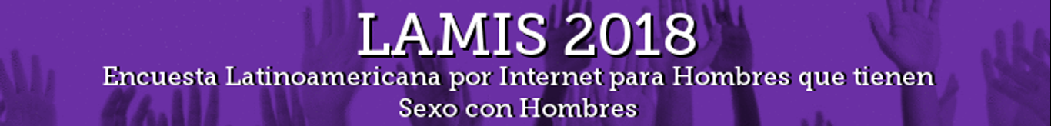
Researchers and intitutions involved in LAMIS study
Peru | Dr. Carlos Cáceres Dr. E. Michael Reyes Diaz | Center for Research in Sexuality, AIDS and Society, Universidad Peruana Cayetano Heredia,
Chile | Dra. Valeria Stuardo | Escuela de Salud Pública, Universidad de Chile
Brazil | Dra. Maria Veras Igor Prado Daniel Barros | Facultad de Ciencias Médicas de la Santa Casa de Sao Paulo
Guatemala | Elsy Camey Dr. Dorian Ramírez | Fundación Sida y Sociedad Universidad de San Carlos de Guatemala
Portugal | Dr. Henrique Barros Paula Meireles | EPIUnit - Instituto de Saúde Pública, Universidade do Porto
Spain | Dr. Jordi Casabona Ana Celly | Centre d'Estudis Epidemiològics sobre les Infeccions de Transmissió Sexual i Sida de Catalunya (CEEISCAT)
Germany | Dr. Uli Marcus | Instituto Robert Koch
UK | Dr. Axel J. Schmidt | Sigma Research, LSHTM
Suriname | Dr. Kai J. Jonas | Faculty of Psychology and Neuroscience - Maastricht University

Slide 23


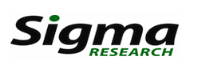
LAMIS2018 was undertaken by the Red Iberoamericana de Estudios en Hombres Gay, otros HSH y Personas Trans (RIGHT) in association with the Faculty of Psychology and Neuroscience, Maastricht University (The Netherlands), the Robert Koch Institute (Germany), and Sigma Research, LSHTM (UK).

Slide 24
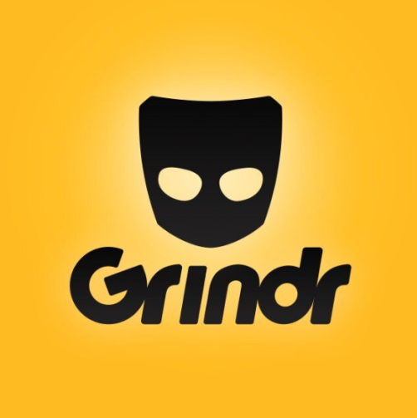
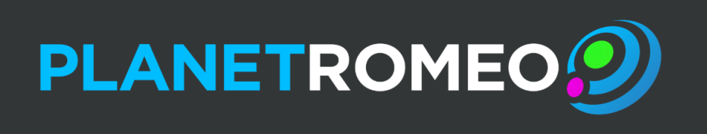
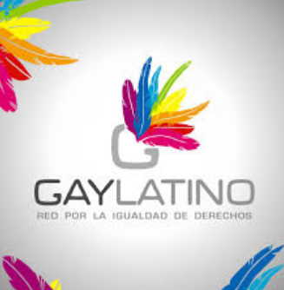
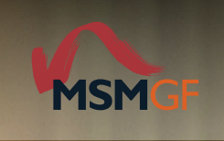
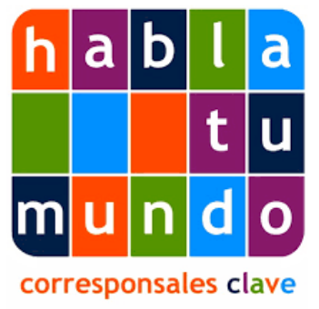
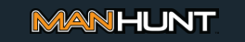
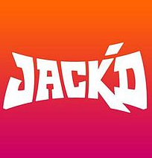
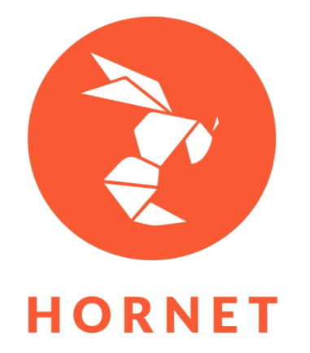
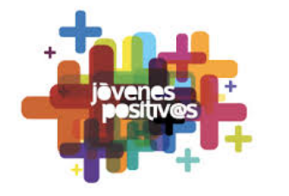
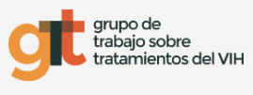
Acknowledgements:
As well as to all the NGOs who act as collaborating partners and of course to all the 65.000 participants who have trusted the project.

Slide 25





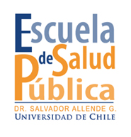





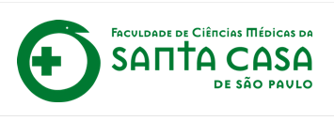
Thank you!
E-mail contact: percy@stopsida.org
edward.reyes@upch.pe
RIGHT contacts:
Ana Celly at rightplus@ceeiscat.cat
Carlos Cáceres: carlos.caceres@upch.pr
Jordi Casabona: jcasabona@iconcologia.net
https://www.red-iberoamericana.net/lamis-eng
http://www.aidsinfoonline.org/kpatlas/#/home

