Slide 1
Improving uptake of prevention of mother-to-child HIV transmission services in Benue State, Nigeria through a church congregation-based approach
Michele Montandon, MD
U.S. Centers for Disease Control and Prevention

Slide 2
Disclosure: No conflicts of interest to declare

Slide 3
Background
Number of HIV-positive pregnant women annually 100,000
New HIV infections in children annually 24,000
Mother-to-child HIV transmission rate in Nigeria 24%
of pregnant women attend ANC
of pregnant women know their HIV status
of HIV-positive pregnant women are on ART
Sources:
UNAIDS 2019 estimates
National HIV/AIDS Indicator and Impact Survey (NAIIS) 2018

Slide 4
Background
High religious service attendance and strong role of religion in daily life
Religion: 49% Christian; 49% Muslim; 2% other
Randomized controlled trial of a congregational approach to preention of mother-to-child transmission (PMTCT) in Enugu State, Nigeria demonstrated improved uptake of HIV testing during pregnancy²
HIV testing uptake: 92% in intervention group vs. 55% in controls, p<0.0001
We report on the results of implementing an adapted congregational approach to PMTCT in Benue State from July 2016-December 2017
¹ Pew Research Center surveys, 2008-2017
²Ezeanolue EE, Lancet Global Health 2015

Slide 5
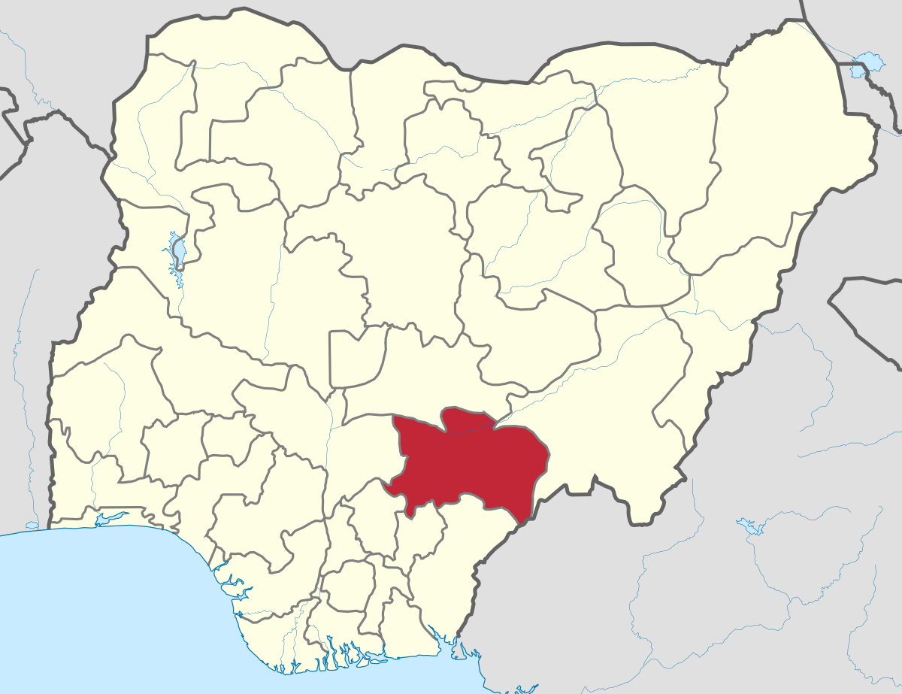
Benue State: Fast facts
Religion: predominantly Christian
Why selected for implementation:
High HIV prevalence
4.8% among age 15-49 years in Benue State vs 1.4% nationally¹
Faith-based PEPFAR implementing partner already providing support for faith-based organizations in the state
¹National HIV/AIDS Indicator and Impact Survey (NAIIS) 2018

Slide 6
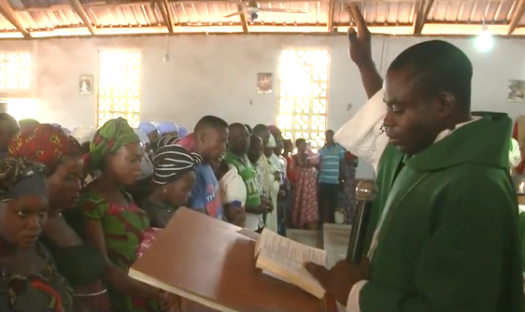
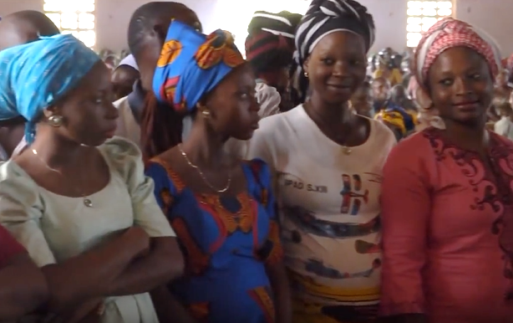
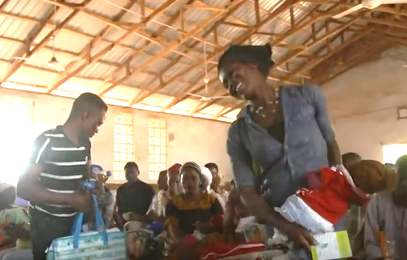
The congregational approach to PMTCT
Church sensitization, enrollment and training
Baby Showers: pregnant women and their partners
Baby Receptions: new parents and their babies
Community follow-up:
Church Health Assistants support linkage to PMTCT
Images courtesy of PBS News Hour
https://www.pbs.org/video/why-nigeria-has-more-hiv-positive-infants-than-anywhere-else-1528930210/

Slide 7
Primary intervention: Baby Shower events

Slide 8
Methods
Site selection
77 congregations selected and enrolled based on capacity and willingness of the church, congregational size, accessibility including proximity to a health facility
Data collection
Questionnaires for all participants in Baby Shower events
Demographics
Pregnancy and HIV testing history
Blood test results: HIV, Hepatitis B and sickle cell
Community follow-up by Church Health Assistants
Linkage of HIV-positive pregnant women to ART
Data management and analysis
Baby Shower and linkage databases merged
Descriptive analysis conducted in STATA 14
Compared Baby Showers results to PEPFAR program data for Benue State

Slide 9
Results: Participation
15,160 participants in 630 Baby Showers
9510 pregnant women
5650 male partners
Median participants per event: 30 (range 12-89)
99.8% of participants had HIV status ascertained

Slide 10
Results: Demographics
Median age, yrs (IQR) | Females: 24 (20-28) Males: 30 (25-37)
Marital status | >99% married
Occupation | 80% farmer 8% trader 12% other
Educational attainment: Completed secondary school | Females: 52% Males: 75%

Slide 11
Results: Antenatal care enrollment
55% of women enrolled in ANC for current pregnancy

Slide 12
Results: HIV testing
HIV positivity by gender
 | Females | Males
HIV positive, n (%) | 696 (7.3%) | 223 (4.0%)
Newly diagnosed, n (%) | 226 (2.8%) | 126 (2.2%)
Previously known, n (%) | 470 (4.5%) | 97 (1.8%)

Slide 13
A higher proportion of pregnant women were newly diagnosed HIV positive in Baby Showers as compared to health facilities
Indicator | Baby Shower data | PEPFAR facility-based program data, 2018¹
HIV-positivity among pregnant women | 7.3% | 7.0%
Newly diagnosed | 2.8% | 1.8%
Previously known | 4.5% | 5.2%
¹ Data from 12 local government areas (LGAs) in Benue State where Baby Showers were conducted

Slide 14
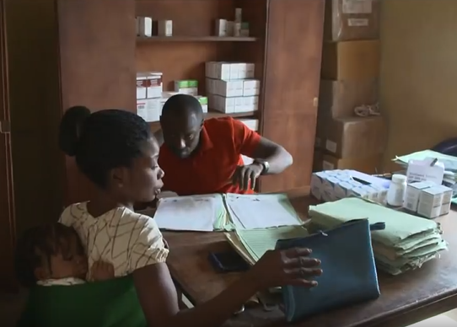
Results: Linkage to ART
83.5% of HIV-positive pregnant women were confirmed to be on ART

Slide 15
Limitations
Programmatic data with potential data quality gaps
Challenges reporting linkage to ART
Limited reliability of self-reported new vs. known HIV status
No linkage data for HIV-positive men
No review of health facility records to confirm linkage
Transferability: most likely to apply to settings with low ANC attendance, low awareness of HIV status, strong religious influence

Slide 16
Conclusions
Baby Showers were translated from research to real-world implementation across multiple sites with standardized implementation monitoring.
Baby Showers were well-attended, including by vulnerable populations with low ANC attendance.
Acceptance of HIV testing was nearly universal, and a higher proportion of pregnant women were newly identifying HIV-positive at Baby Showers as compared to health facilities.
The congregational approach to PMTCT led to:
Identification of HIV-positive pregnant women
Linkage of HIV-positive pregnant women to ART
Male case finding

Slide 17
Implementation experiences and lessons learned
Experience |  | Lessons learned
Challenge giving same-day test results at a celebratory event |  | Requires privacy and sensitivity
Participants value the multi-prong intervention |  | Balance providing multiple services and ease of implementation
Intervention addresses maternal health, not only HIV |  | Foster partnerships with other MCH stakeholders

Slide 18
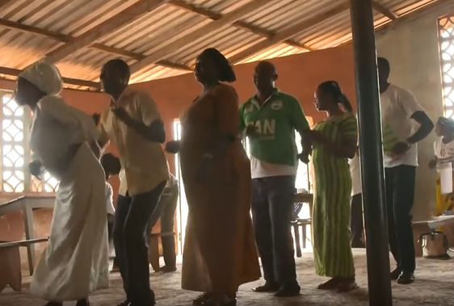
Next steps
Implement Baby Showers in strategic settings in Nigeria
Assess feasibility of adapting for Muslim communities/mosques
Conduct analysis of cost

Slide 19
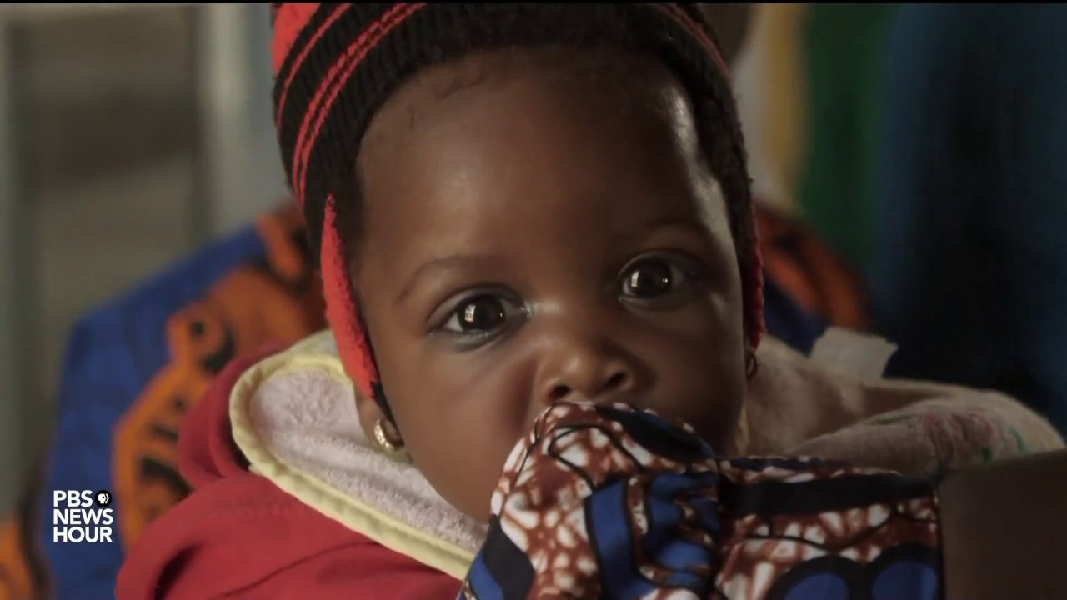
Additional resources
Baby Showers in the news, World AIDS Day 2018: https://www.pbs.org/video/why-nigeria-has-more-hiv-positive-infants-than-anywhere-else-1528930210/
Contact for further information including tools and SOPs: nkf3@cdc.gov

Slide 20
Acknowledgements
Catholic Caritas Foundation Nigeria
Dr. John Oko
Dr. Chukwudi Onwuchekwa
CDC-Nigeria
Dr. Timothy Efuntoye
Dr. Jerry Gwamna
Dr. Ibrahim Dalhatu
Dr. Ademola Oladipo
Dr. Amee Schwitters
Dr. Chibuzor Onyenuobi
Dr. Mahesh Swaminathan
CDC-Atlanta
Ray Shiraishi, Ph.D.
Nigeria National AIDS and STI Control Programme
Dr. Moses Aboje
University of Nigeria
Echezona E. Ezeanolue
Amaka G. Ogidi
Chima Onoka
Ijeoma Itanyi
Dorothy Ihekuna
Chioma Onu
Nnabundo Musei
Healthy Sunrise Foundation
Dina Patel
Semiu Gbadamosi
Adaeze Chike-Okoli
Michael Obiefune
Jacob Onu
Babayemi Olakunde
Participating congregations: Religious leaders, church volunteers, pregnant women and their partners
This project has been supported by the Centers for Disease Control and Prevention (CDC). The findings and conclusions in this presentation are those of the authors and do not necessarily represent the official position of the CDC.

Slide 21
Thank you

