Slide 2
Predictors of discontinuation in Brazil's free-of-charge PrEP program
Isabela Ornelas Pereira
Share your thoughts on this presentation with #IAS2019
Notes:
Buenas tardes!
Good afternoon, my name is Isabela Ornelas and on behalf of the Department of diseases of chronic conditions and STIs from the Ministry of Health of Brazil, I want to thank the opportunity to be here / sharing this study of PrEP discontinuation.

Slide 3
No conflict of interest to disclosure.
Notes:
I have no conflict of interest to disclosure.

Slide 4
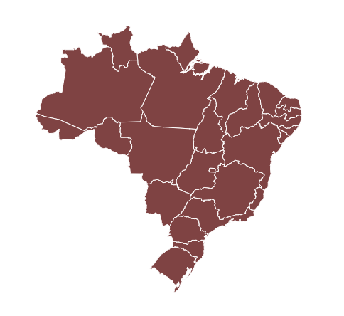
PrEP in Brazil
Additional prevention CHOICE for people at substantial risk for HIV infection
Daily dosing of TDF+FTC
Since January 2018
Brazilian public health system (SUS)
Individuals over 18 years old at greater risk for HIV
Notes:
PrEP in Brazil is offered as a CHOICE … for people at substantial risk for HIV infection as part of a combination HIV prevention approach
The TDF/FTC daily-dose medication is used by HIV-negative individuals to reduce their risk of becoming infected.
- it has been offered since December twenty eighteen
- Through the Brazilian public health system,
- Free of charge
- For individuals over 18 years old at greater risk for HIV
Let’s take a better look who these individuals are [CLICK]

Slide 5
Brazil’s PrEP Guidelines
Priority targets
Gays and other Men who have sex with men (MSM)
Trans people
Sex workers
Serodiscordant partnerships
Elegibility criteria
Unprotected anal or vaginal sex (past 6 months)
Recurring Sexually Transmitted Infections (STI)
Repeated HIV Post-Exposure Prophylaxis (PEP)
Other HIV vulnerabilities
AND
Notes:
Our priority populations for PrEP use are
Gays and MSM,
Transpeople
Sex workers and
people who has serodiscordant sexual partnerships
But simply being part of one of these groups is not enough, it is necessary to observe other contexts associated with an increased risk of infection
Therefore, the recommendation is/ being part of one of these groups [CLICK] AND meeting at least one of these criteria: [CLICK]
Sexual condomless practices with penetration, AND/OR
Recurring STIs, AND/OR
Repeated use of HIV Post-Exposure Prophylaxis , AND/OR
Other HIV vulnerabilities… like drug use, number of partners..
We all know that PrEP is safe, well-tolerated and highly effective. We’ve seen data in published papers and in other presentations right here at the conference.
What led us to a question:

Slide 6
Why PrEP use is discontinued?
Reasons listed on Brazil’s PrEP questionnaire
HIV seroconversion
Adverse events
Low adherence
Suspected acute viral infection
User’s decision/choice
Cost
Notes:
Why PrEP use is discontinued?
We listed some possible reasons on our questionnaire [CLICK]:
- HIV seroconversion
- Adverse events
- Low adherence
- Suspected acute viral infection
- User decision
We usually see PrEP cost as a reason for discontinuation, but as I told you before... in Brazil, PrEP is free of charge.
So, I’ll get back to this particular reason: “user’s choice”

Slide 7
Why PrEP use is discontinued?
Reasons listed on Brazil’s PrEP questionnaire
HIV seroconversion
Adverse events
Low adherence
Suspected acute viral infection
User’s decision/choice
Cost
X
Notes:
You see… here we’re talking about a little box on PrEP questionnaire that we fill out [CLICK]/ when the user come back to say: “hey, I don’t want to use PrEP anymore”. Maybe she or he has chosen other prevention methods/ or changed risk behavior…and that’s ok!
But what happens is that they represent less than 3% of the discontinued PrEP users [CLICK]

Slide 8
Why PrEP use is discontinued?
Reasons listed on Brazil’s PrEP questionnaire
HIV seroconversion
Adverse events
Low adherence
Suspected acute viral infection
User’s decision/choice
Cost
X
Failing to attend follow-up visit
Notes:
the majority of the ‘discontinued PrEP users’ are those that didn’t return to tell us that.

Slide 9
PrEP discontinuation (lost to follow-up)
97%
just didn’t return
Notes:
As an example, if someone goes to the first appointment and gets PrEP for thirty days, but fails to come to the follow-up visit in thirty days, we will consider a lost to follow-up just after fourty-two days.
We wait for this extra fourty percent days to finally consider that person as a ‘discontinued PrEP user’.
This lost to follow-up group represents ninety-seven percent of discontinued users.
_____________________________________________________________
QUESTION:
-40% was used since we have seen in the literature that a substantial protection of 96% reduction of HIV risk can be reached with 4 doses a week, which represents missing around 40% of the doses.

Slide 10
PrEP discontinuation (lost to follow-up)
Jan-Dec/2018
1 HIV+
4 Adverse events
4 blood test alterations
10 user’s choice
6,079
users enrolled
5,388
users attended
691
users descontinued
(lost to follow-up)
n DAYS
n DAYS + 40%
Notes:
That’s what we have in our database for twenty eighteen.
Six thousand and seventy-nine individuals who went to the first appointment, were elegible and got PrEP.
Of those, five thousand three hundred and eighty-eight returned to their first follow-up visit. Among these five thousand there were some discontinuation as you can see in this short list in the right.
Six hundred and ninety one didn’t show up in the scheduled follow-up visit, neither after the buffer time.
So these are our discontinued PrEP users by lost to follow up.
Of course some of those five thousand may have discontinue in other moments after that, but in this analysis we are looking specifically to those six hundred and ninety one who discontinued before he first follow-up visit.
As they represent most of our discontinued users, we decided to take a closer look.
We still didn’t know exactly WHY they didn’t come back, but we were able to look WHO is more likely to discontinue PrEP use.

Slide 11
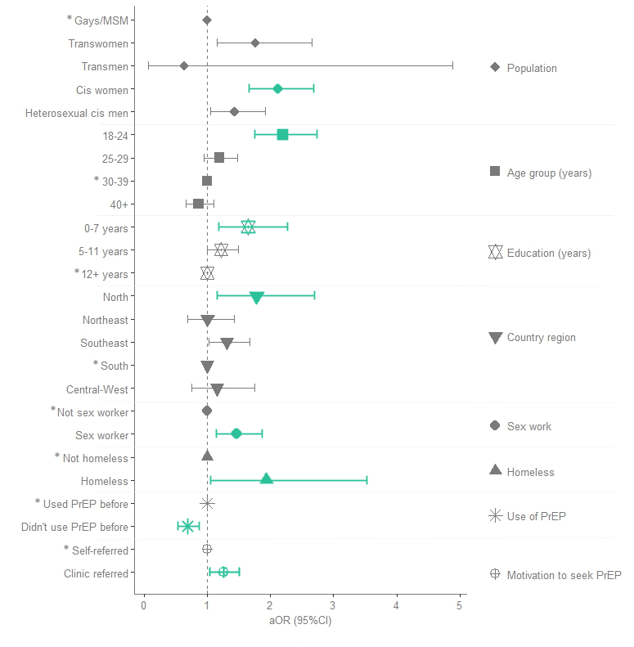
Likelihood of PrEP discontinuation
Notes:
We used multivariable logistic regression model to assess the likelihood of PrEP discontinuation considering demographic and behavioral predictors.
Here we have population, Age group, education level, country region, sex work, homelessness, preview use of PrEP and motivation to seek PrEP.
And we found that ….

Slide 12
Who discontinue PrEP?
aOR
Reference group
Cis women
2,12
Gays/MSM
Transwomen
1,76
Gays/MSM
Younger users (18 – 24)
2,20
30-39
Lower education level (0-7 years)
1,65
12+ years
Living in Northern region
1,78
Southern region
Sex worker
1,47
Not sex worker
Being Homeless
1,94
Not homeless
Clinic/NGO referred
1,26
Self referred
Used PrEP before
0,69
Didn’t use PrEP before
Notes:
Some groups are more likely to discontinue than others.
The characteristics positively associated to PrEP discontinuation were
Being cis or transwomen
younger users,
Having lower education level
Living in northern region
Being a sex worker
Being homeless
- And being referred by a clinic or a NGO rather than self-referral
We have seen that having used PrEP before were related to NOT discontinuing PrEP.

Slide 13
What can we do?
Qualifying our data
Guide health services to deliver tailored strategies to overcome specific barriers
Better counseling
Enhanced psychological support to groups more susceptible to discontinue PrEP
Facilitating re-engagement for people that have discontinued PrEP
Notes:
Understanding characteristics of users who are most-likely to discontinue PrEP is crucial to guide health services to deliver tailored strategies to overcome specific barriers.
With better counseling, / enhanced psychological support to groups more susceptible to discontinue PrEP / and Facilitating re-engagement for people that have discontinued PrEP
This actions, with an extra-careful look to those predictors, during early PrEP visits may increase continuation in care and strengthen PrEP as public health policy.

Slide 14
References
Grant RM, Lama JR, Anderson PL, et. al. iPrEx Study Team. (2010). Preexposure chemoprophylaxis for HIV prevention in men who have sex with men. The New England Journal of Medicine, 363(27), 2587-2599.
Anderson PL, Glidden D V, Liu A, Buchbinder S, Lama JR, Guanira JV, et al. Emtricitabine-Tenofovir Concentrations and Pre-Exposure Prophylaxis Efficacy in Men Who Have Sex with Men. Sci Transl Med. 2012;4(151).
Liu AY, Yang Q, Huang Y, Bacchetti P, Anderson PL, Jin C, et al. Strong relationship between oral dose and tenofovir hair levels in a randomized trial: hair as a potential adherence measure for pre-exposure prophylaxis (PrEP) PLoS ONE. 2014;9(1):e83736.

Slide 15
Thank you!
Isabela Ornelas Pereira
isabela.pereira@aids.gov.br

